Slide 1
Microsoft Teamwork Solutions Development

Slide 2

Agenda
Teams Developer Platform – Overview and Opportunity
Building Apps and Solutions with Microsoft Teams
Extend your solution with Microsoft Graph
Building Teams Apps using Solution Accelerators
Teams Lifecycle management and Design Guideline for Apps

Slide 3
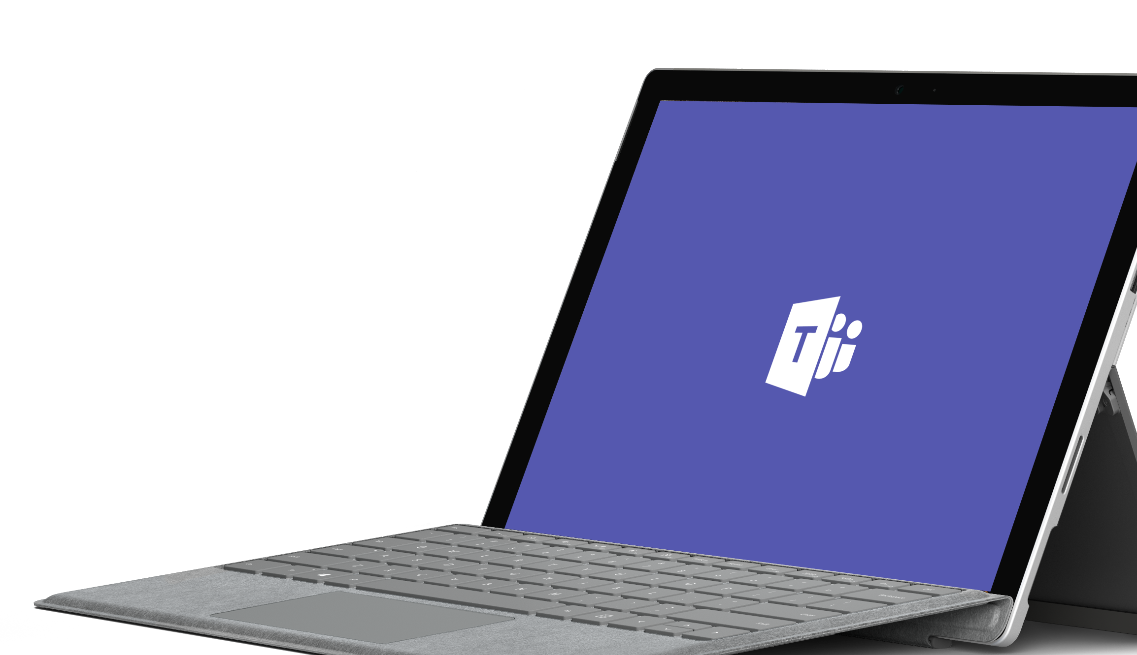
Microsoft Teams
Notes:
Microsoft Teams is the fastest growing business application in Microsoft history.
A couple of stats for you:
13M daily active users
Over 500,000 organization are using Teams.
91% of the Fortune 100 companies use Teams.
181 markets are using Teams with support for 53 languages and growing
But really the stat that I love is this stat which is over 200 organizations have 10,000 or more active users.

Slide 4
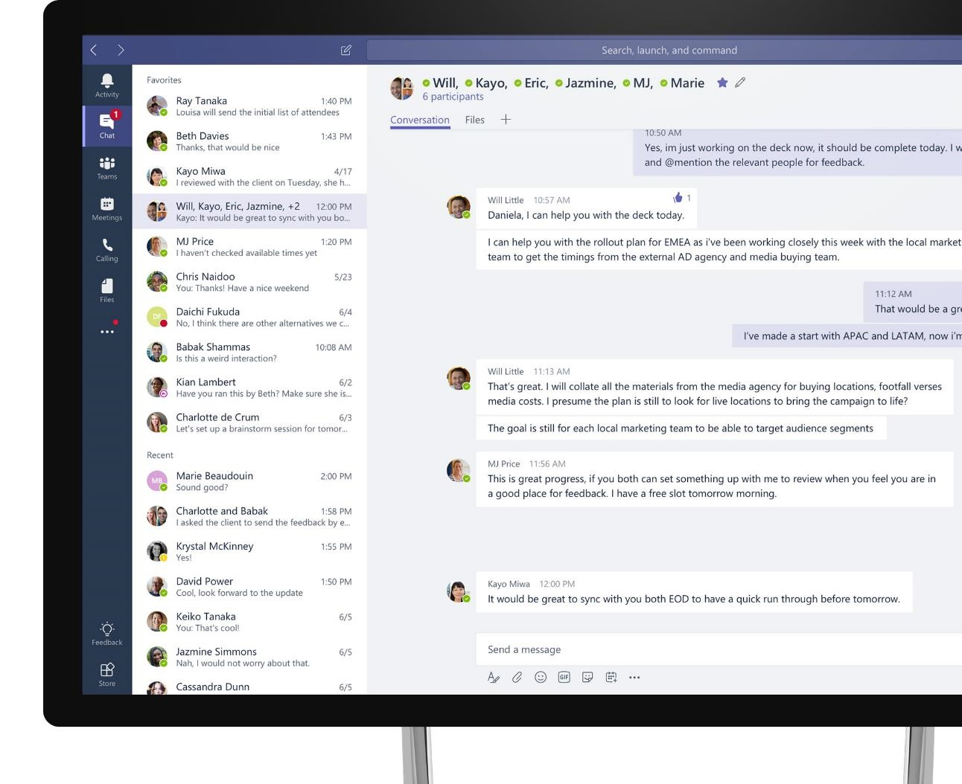
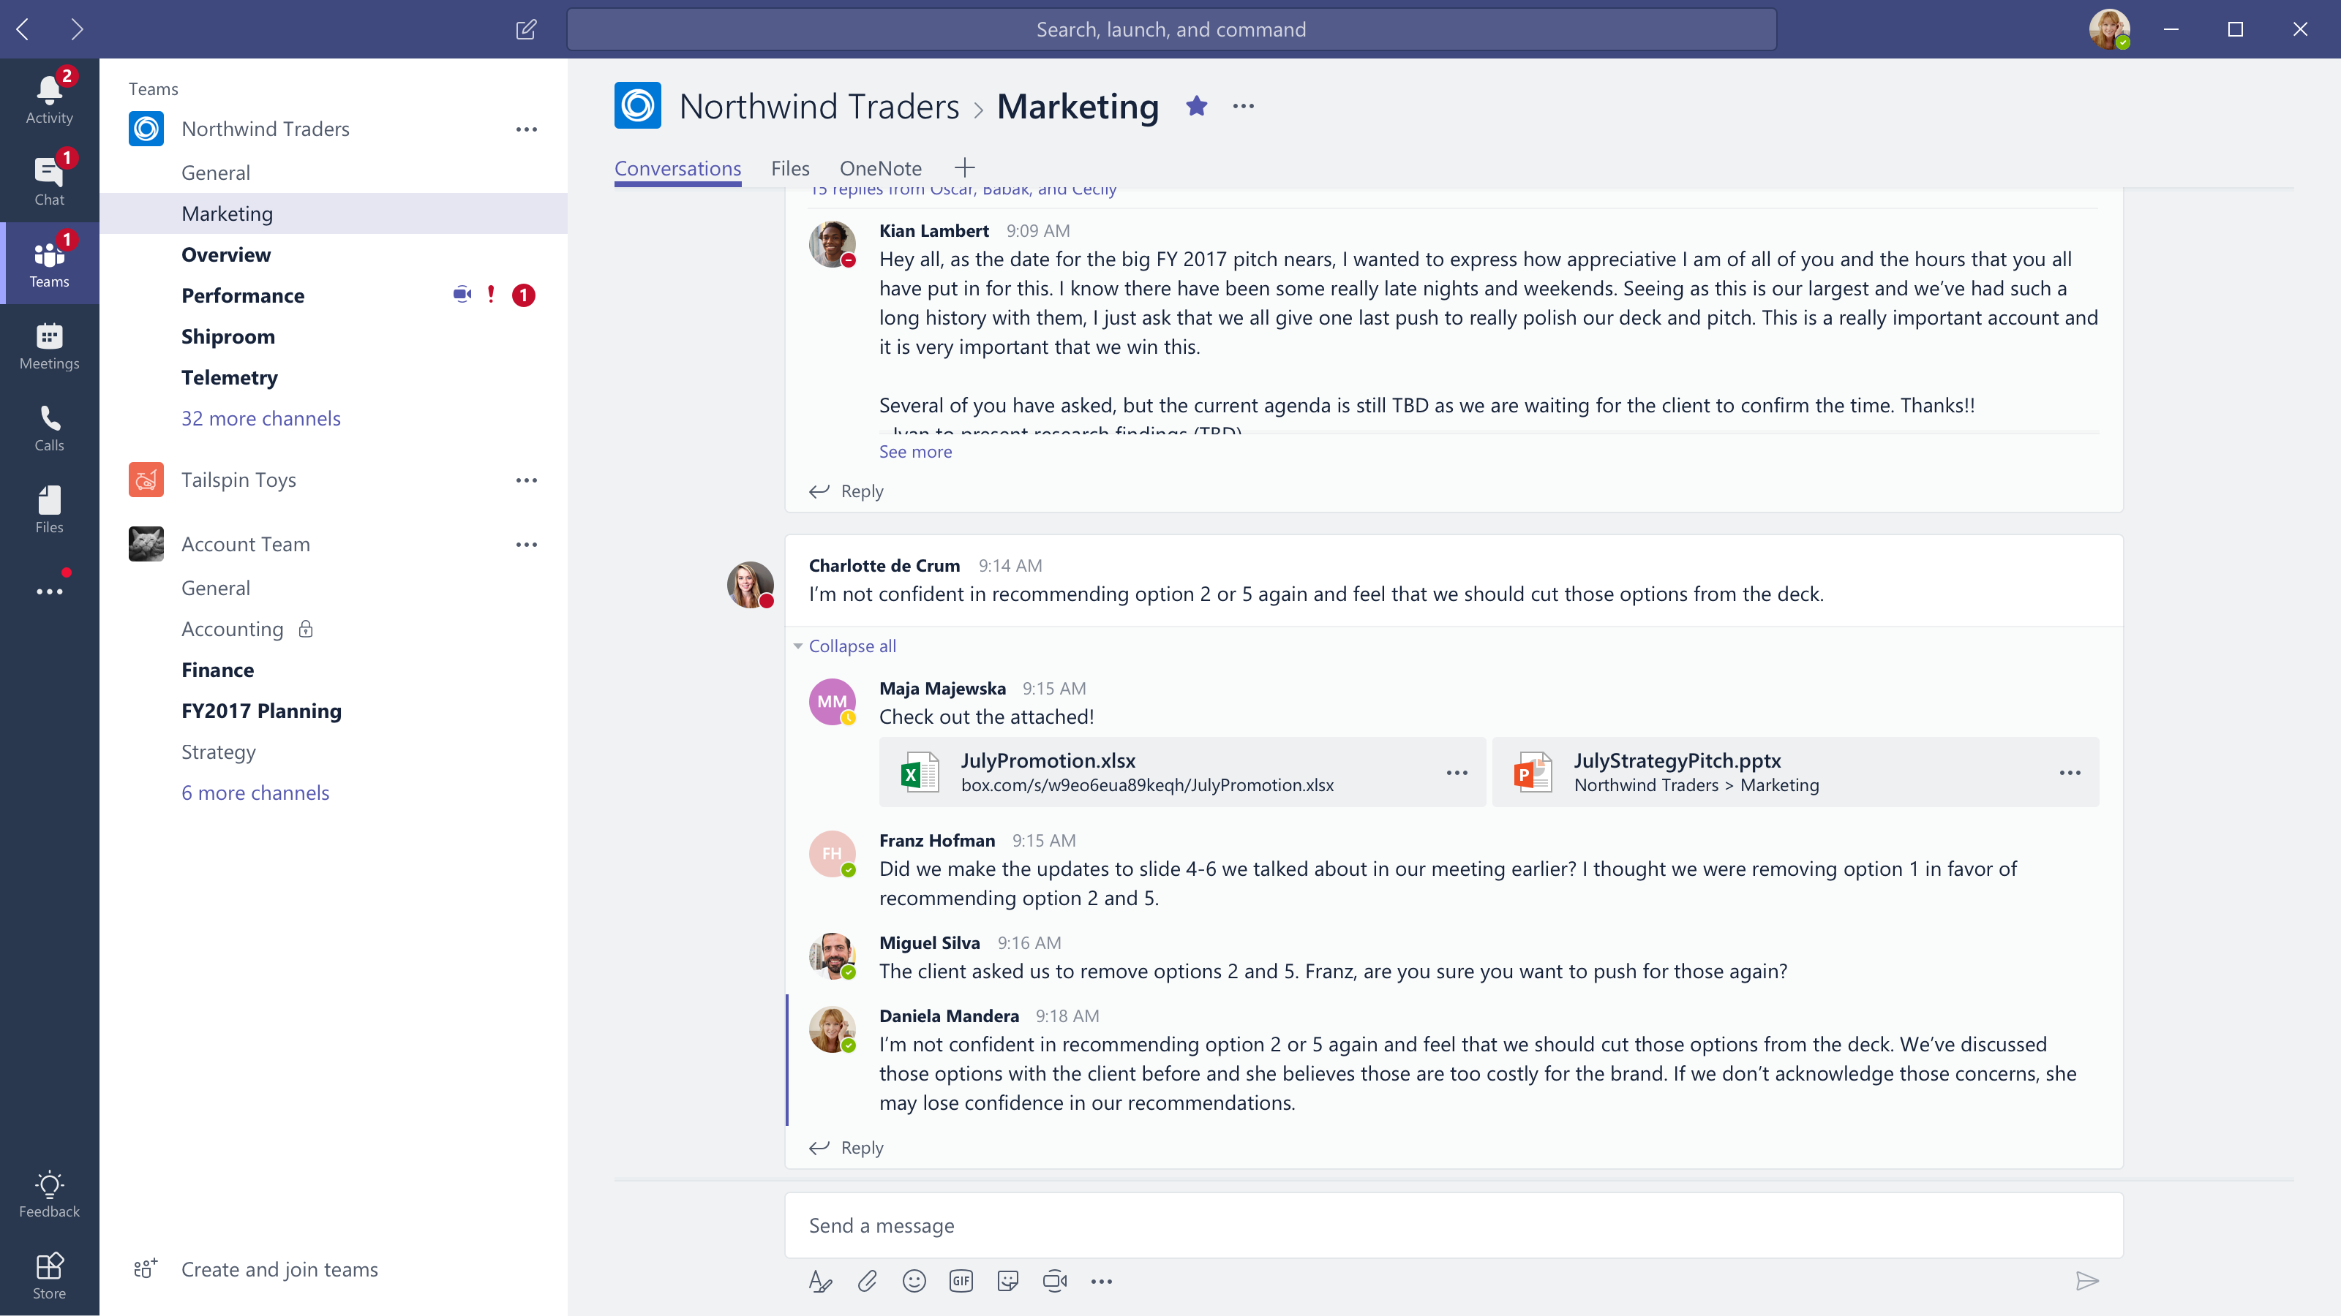










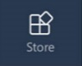
Microsoft Teams
The hub for teamwork in Office 365
Communicate
through chat, meetings & calls
Collaborate
with deeply integrated Office 365 apps
Customize & extend
with 3rd party apps, processes, and devices
Work with confidence
enterprise level security, compliance, and manageability
Notes:
[This is an animated slide. Please show it in presentation mode]
[MAIN POINT TO LAND]
Microsoft Teams is a hub for teamwork, a chat-based workspace that enables teams to be more productive by giving them a single and secure location that brings together everything a team needs: chats, meetings, calls, files, and tools. Microsoft Teams is one place for all the needs your teams have.
Microsoft Teams delivers on four core promises to create a digital workspace for high performing teams.
[COMMUNICATE]
First, Microsoft Teams solves for the communication needs of a diverse workforce.
Since preview, Microsoft Teams has evolved to include a complete meetings experience, as well as chat, voice and video -
You can use Teams for informal 1:1 or group chats – directly on your phone if you’re on the go. Or you can have an open conversation in a channel. This enables people to share information in a transparent way to accelerate decision making. And it's super easy to move from a chat into a face to face meeting, helping you to bridge geographical barriers.
[COLLABORATE]
When it comes to collaboration, the deep Office integration enables today’s multigenerational workforce to use the Office apps they are familiar with and love - Word, Excel, PowerPoint, OneNote, SharePoint, Planner, even Power BI - right within the context of Teams. Teams is unique in how we enable collaboration.
Today, when you want somebody’s feedback, you send them the file via email, they store it locally with comments, you store it again…… it's a vicious cycle that results in v2, v3, v4 versions – and you have to jump between email and other apps to get the work done. Teams brings all the Office 365 services together – so that you can easily share and co-author files without the need for email attachments.
[CUSTOMIZE]
Many of you use other services than Office 365 as well which results in you having to jump between and spend time in disparate experiences. We built Teams to not only be the hub for Office 365 services, but for all the services and tools teams use on a day to day basis. So, you can customize Teams with tabs, connector and bots to include the apps and services you need - <mention relevant 3rd party apps like GitHub and Trello that can be included in Teams>– we have integrations with over 150 partners. For our developer community, we have also created an extensible platform, to enable building apps and to integrate with business processes.
[WORK WITH CONFIDENCE]
Microsoft Teams comes with the enterprise grade security, compliance and manageability that you expect from Office 365 which customers tell us is a huge value add for them.

Slide 5
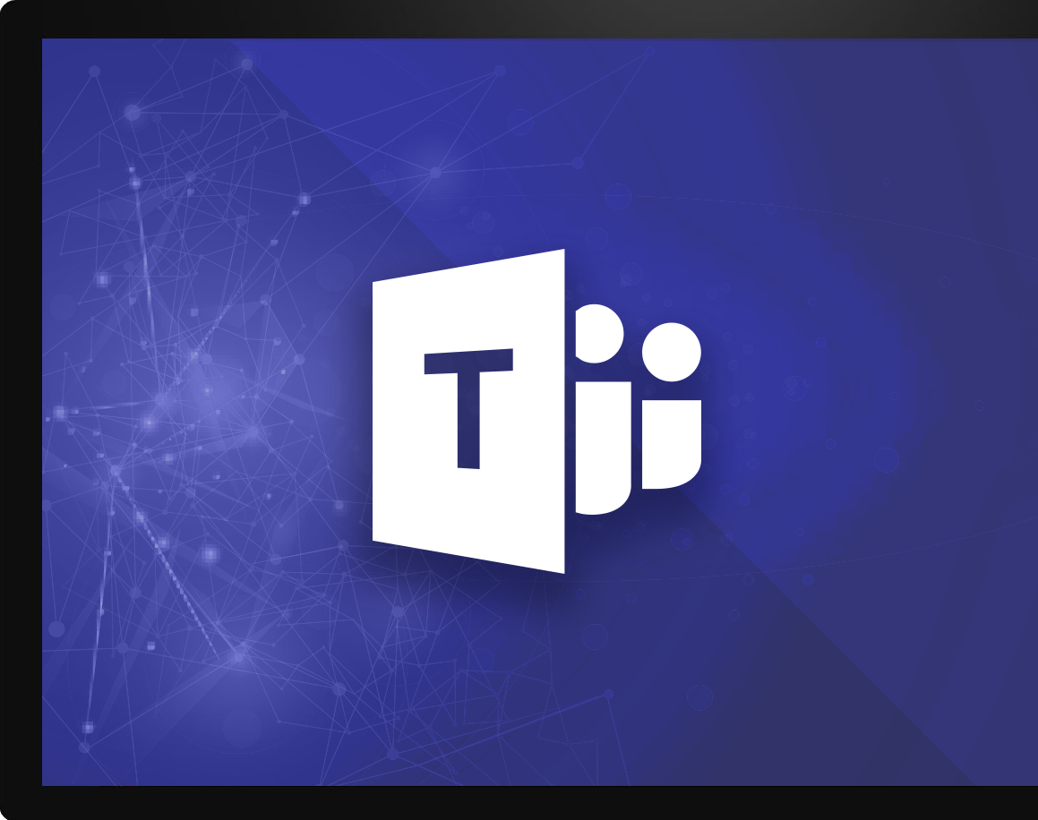
Microsoft Teams Platform
build experiences that people love
Communicate
through chat, meetings & calls
Collaborate
with deeply integrated Office 365 apps
Work with confidence
enterprise level security, compliance, and manageability
Customize & extend
Gain context without switching context
Meet your people where they are
Tailor your teamwork
with 3rd party apps, processes, and developer tools
Notes:
Talk track: And core to that are the investments we’ve made in the Teams Platform, allowing users & developers alike to customize and build on Teams, in order to deliver experiences that your people & customers LOVE.
And when it comes to the platform and the value that our customers are seeing from it, we are seeing three distinct categories emerging:
Gain context without switching context: Teams pillar of integration (the single hub for Office) but also the ability to simply curate your experience so you reduce the information overload you get every day and focus on the content that's most relevant to you to get your job done, better. INFUSION
Meet Your people where they are: Bring together all the apps and tools your organization is already using, into one user interface. Guess what, for IT that means better & easier management, reduced security threats, and more time you can spend on valuable, forward-looking projects. For end users, #1 just got even better. (opportunity to share a 3rd party apps slide here)
Tailoring your experience: to me, this delivers superpowers to people through proactive intelligence. This is the core to the extensibility of the Teams platform. Deliver intelligent experiences using our APIs and/or our partner community that:
First: make the most difficult and time-wasting tasks at work, easy
Thereafter: drive intelligence to your people that allows them to understand how they add more value to the organization, and then deliver it more efficiently & quickly

Slide 6
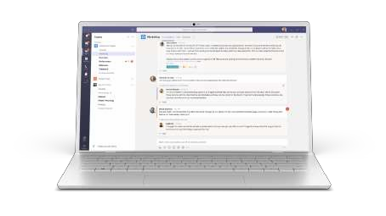
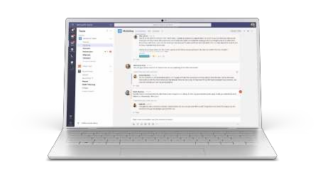
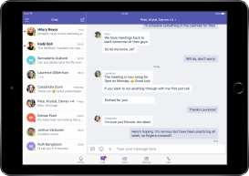


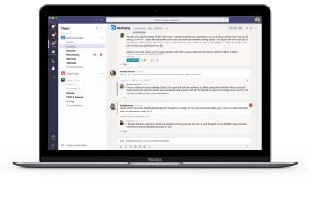





Cross platform presence – Teams where you want it
Desktop
Mobile
Browsers
Windows 7+
iPad
Edge
Chrome
Firefox
OS X 10.10+
iPhone
Android

Slide 7






STANDALONE WEB, DEVICE, AND SERVICE APPS
Conversation are Core to the Office 365 Platform
EXTENSIONS


EMBEDDED CANVASES
Microsoft Graph
External Data & Content

Slide 8

Transformation of the Modern workplace
4
Then
Now

Slide 9




Capabilities
Extensible platform
Bots
Tabs
Build apps with a rich set of capabilities to enable these higher performing teams and reach your users in their chats, channels, notifications, and personal workspace.
Drive engagement by submitting your app to the Office Store.
Help users get tasks done in calls, conversations and online meetings
Surface rich content within Teams
Notifications
Messaging extensions
Engage users via channel & feed notifications
Allow users to query and share rich cards in conversations
Commands and Actions
MS Graph
Power your apps using Graph. Automate teamwork and add richness using data from M365
Trigger commands to kick off workflows or search content
Scopes
Publishing Modes
Sideloading
App Store
Company Store
Team
Personal
Collaborative experiences
Productivity experiences
For testing and development
ISVs building for Teams
Deploy using private app store
Notes:
As I mentioned, we’re building a platform and Teams is a very extensible platform with many capabilities.
Think of this as the way for your employees to interact with your application or for your application to interact with employees.
Whether that’s through chats, channels, notifications, or in their personal workspace on their Teams workspace.
Some of these are bots. Most people are familiar with bots. One popular one would be where you’re asking questions and getting answers by just pulling up a bot.
Tabs give you a rich surface, where you can really post your application in any of the information from your app in a tab so it’s right there for users or you can actually post an application in a tab.
Notifications, whether it’s in a feed or whether it’s in a channel so you can notify people for example if something changed in your application that you’re extending into Teams, you can provide that notification to users.
Messaging extensions are a way to provide a way for people to actually pull something up, and query and share rich cards in conversations and by the way users can take actions on those cards give you input back and based on that input you provide additional information.
You have command and actions that could either kick off a workflow source search content.
Again, one of the things that’s important to think about is you have the ability to put something in a team environment where it’s something that for example, putting in a channel with multiple people, or you’re putting into someone’s personal channel where it’s really something geared just for the individual and in terms of how can you publish things.
We do allow you to sideload things for testing and development.
If it’s a fully customized packaged solution, that’s something you could build and publish in the Teams app store or if it’s a custom application, that’s really been customized for just one individual customer, that’s something you can deploy using the app store.
Think of each customer as having a private app store for their company where you can load it.

Slide 10


Microsoft Teams provides a powerful and extensible platform
Build apps using rich capabilities to empower your users in chat, channels, and personal workspace
Distribute and manage your app
Enterprise Developers
Upload to your organization’s app catalog
Tabs
Bots
Surface rich content within Teams
Help users get tasks done in conversations
ISVs Partners
Publish to AppSource to make available in the Teams app store
Messaging Extensions
Notifications
Allow users to query and share rich cards in conversations
Post rich updates to channels via connectors
Administrators
Assign policy for apps over end users. Preinstall and pre-pin apps to drive adoption
Adaptive Cards
Q
Voice and video
Add rich interaction to your connector cards
Add rich calling and meeting automation and media
Microsoft Graph
Power your apps using Graph. Build intelligence and connect to data that drives productivity
Notes:
Microsoft Teams has an open developer platform with a rich set of capabilities to build apps or integrate with new or existing business processes and services.
Tabs allow you to surface rich content within Teams, so you can bring the tools and services your team cares about right into a channel or private chat. Add rich dashboards and data visualization, collaborate on documents and note taking, manage tasks across the group, share designs.
Bots help users get tasks done in conversation in Teams. Bots can do things like kick off workflows and provide status on them, give and receive kudos from team members, create lightweight surveys to gauge employee satisfaction, and answer natural language questions about sales and customer usage data.
Connectors help bring useful information and rich content from external services into channels in Microsoft Teams. Get social media notifications, updates about pull and push requests, news updates.
With Actionable messages, you can add rich content to your connector cards.
Compose extensions allow users to query and share rich cards in conversations.
Activity feed notifications engage users via feed notifications.
To learn more about the Teams developer platform, visit the Office Dev Center at Developer.Microsoft.com/Microsoft-Teams.

Slide 11









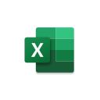








Evolve how your people work, with the tools they need
Vertical solutions
Healthcare
Manufacturing
Retail
Banking
Custom
Apps
Organization-based applications
Departmental tools
Employee resources
Support & info
Processes & workflow
Partner applications
Ready to use
Office 365
applications
Notes:
(first slide build is auto)
So one of the beauties of Microsoft Teams is that Teams really is the hub for where people get work done and so they want to make sure that all the tools they need are a part of Teams.
So they don’t have to change contacts and we think of this as two different types of applications.
The first part of customizing and extending Teams is bringing together all the Microsoft Office applications you know and love, allowing you to reduce context switching and create conversations around content.
(click to build)
The second part of this infusion of tools is where we bring together all the other apps and services you need every day to get your job done, whether or not Microsoft built them.
Our Teams store currently has over 250 of our partner applications and integrations available today, and growing.
Just to clarify the point, these first two layers here are ready to use applications available for you
As soon as you download Teams, should your IT admins make them available to you.
(click slide to build)
Finally, this is where things get interesting. Microsoft Teams also gives you the ability to extend
Your experience to leverage the apps and services that your organization has built for you.
The tools you need to leverage every day as an employee to get work done and as part of your role.
We call these line of business applications.
Now, when you look at this picture, it’s exciting. Imagine a day where all your applications
(click to build slide)
not only show up in one single UI, but also work better together, allowing you to stay in the flow of your work.
That day is here and it’s time to deliver your people the modern workplace they deserve
And make their apps work for them

Slide 12















App scenarios across different industries and horizontals
Industry Vertical
Airlines, Transportation
Flight / route crew communication hub
Local crew shift management
Financial Services
Proposal Manager for commercial banking
Content sharing with compliance
Retail and Consumer Goods
Supply chain real time collaboration
Shift, pricing, and inventory management
Mining, Oil, and Gas
New location development
Daily quality monitoring and analysis
Government
Emergency/disaster response and recovery
Citizen service: permitting and licensing
Healthcare
Patient care coordination
Telemedicine
Manufacturing
Key accounts inventory, logistics
Change order services
Power and Utilities
Field service real time remote assist
Billing and customer management
Real Estate and Construction
Leasing office tenant management
Real estate customer engagement
Horizontal
Marketing
Brand partnership hub
Industry event planning
Marketing hub
HR
Recruiting tool
New hire onboarding and support tools
Project management
Billable hours management
Client engagement hub
Service desks
Self-service knowledge base
Customer service desk
Procurement center service
Firstline workers
Shift management
Remote worker task management
Notes:
These types of business solution opportunities around Teamwork are pretty much endless!
From airline, retail, healthcare, legal firm, real estate, different industries and different functions. You can envision with your customers, understand their business process and teamwork needs, and connect Teams to the tools and services they use everyday to help them fully realize Teams’ value.
The purpose of this slide is to give you some ideas, to start thinking about what your customers need.

Slide 13
Teams apps in various contexts
Team and channel
Enable public collaboration and workflows with all team members
Example: share, discuss, and get notified about new service incidents
Custom-tailor your app’s functionality depending on which of these contexts you will support
Chat
Lightweight collaboration in 1:1 or group setting without complex permissions
Example: 1:1 topics between manager and direct report
Personal
User-centric view, showing aggregate content along with private bot chat
Example: list of all tasks assigned to me

Slide 14
A Microsoft Teams app
Your Microsoft Teams App
Application
app.zip
Web pages with server side and client side logic
manifest.json
Web API—for Bots and business logic
color.png
Azure portal & Outlook Connector portal
outline.png
Background jobs
Bot Framework channel registrations
Outlook Connector registrations

Slide 15
Building apps
Get Started
Define your app in App Studio
1
2
Connect your service
Embed your web app or add NL/search commands over your existing service
Automate teamwork
Plug into Graph to automate team lifecycles
3
4
Add rich comms
Integrate voice and video to light up new interactions
Publish
Submit to AppSource or your tenant’s app catalog
5

Slide 16
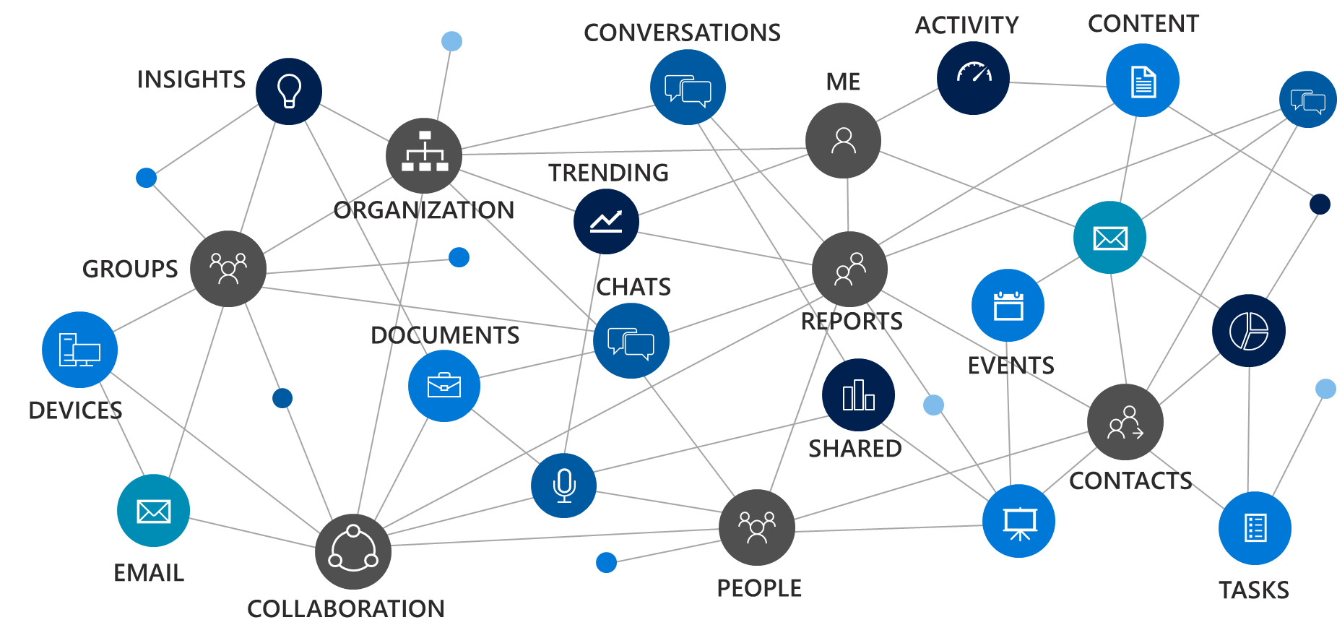
Introduction to Teams App Studio
Notes:
Most of you came to this conference because you have real customers that have data in Microsoft Services. Microsoft Graph is the way to access that data.

Slide 17

App Studio
App Studio
App Studio is a Teams app made for developers which:
Eliminates the need to manually craft an app package
Consolidates many registration and management experiences and reduces them down to single clicks
Provides a continually expanding set of tools such as a Card Editor to make the inner loop development process easier
Is itself built on the Teams platform and can be installed like any other app

Slide 18
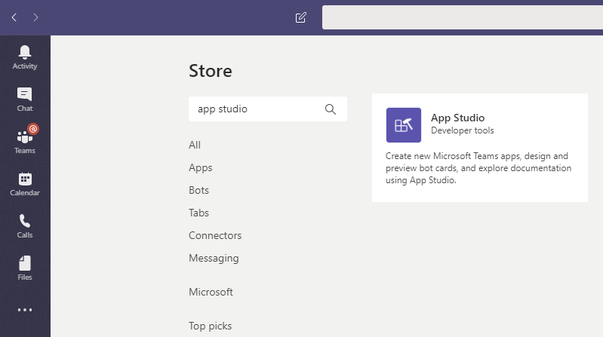
Teams.1: Get App Studio from Store
In Teams, click Apps button, search for “App Studio”, install.

Slide 19
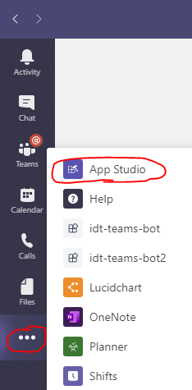
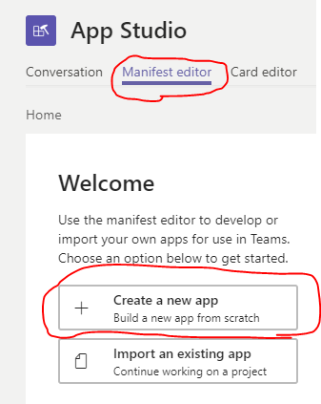
Teams.2: Go to App Studio, create an app
Go to App Studio > Manifest editor > Create a new app

Slide 20
Teams.3: App details
Use “idt-teams-bot” for short name, long name & short description.
Use “idt-teams-bot long description” for the long description.
Generate an App Id
Use “com.mycompany.idt.bot” for package name, “0.0.1” for version.
Use “idt-teams-bot” for Name
Use http://www.mywebsite.com for all urls.

Slide 21
Teams.4: Add existing Bot
Under Capabilities->Bots choose “Set up” Existing bot.
Name: “idt-teams-bot”
Bot ID: Either “Select from one of my existing bots” if logged into the same AAD account, or “Connect to a different bot id” and paste in the Microsoft id found in the appsettings.json file of the bot.
(if connected instead of selected):
Endpoint: https://idt-teams-bot.azurewebsites.net/api/messages

Slide 22
Teams.5: Add domain to validate & install
Under Finish > Valid domains, add “*.botframework.com” as a valid domain.
Under Finish > Test and distruibute, click “Install”
Choose Personal and Team checkboxes.
Click “Open” to open the Bot to begin testing.

Slide 23
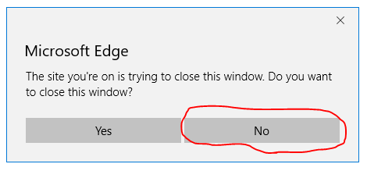
Teams.6: Test your skill
Type “hi” (Bot says “Hello.”)
Type “schedule a meeting” (Bot requests a login) click “login”
Log in to your non-AAD account, but do not close the window.
A validation code will appear. Copy the code.
Paste the code into the conversation with the bot.
(follow further prompts in the conversation to set up a meeting)

Slide 24
Adaptive Cards

Slide 25

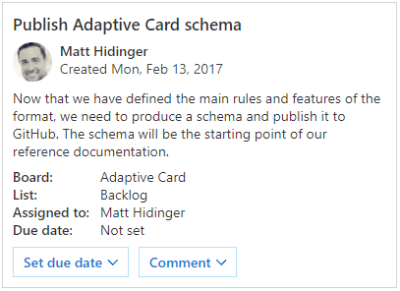
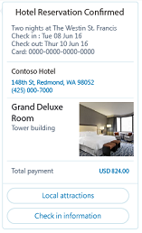
Using Cards in Bots
Adaptive Card
A customizable card that can contain any combination of text, speech, images, buttons, and input fields.
Supported in Teams, Outlook, Windows, etc.
Hero
Largest card
Best used for articles, long descriptions or scenarios where your image is telling most of the story
Receipt
A card that enables a bot to provide a receipt to the user. It typically contains the list of items to include on the receipt, tax and total information, and other text.
Notes:
This is a sample of cards that can be used. Refer to https://docs.microsoft.com/en-us/microsoftteams/platform/concepts/cards/cards-reference for details

Slide 26
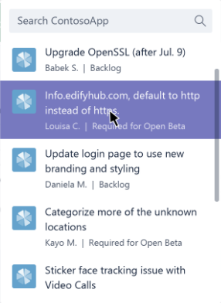
Using Cards in Messaging Extensions
Respond with attachment layout of “List”
Format each query result as a card
Adaptive Card
Hero Card
Thumbnail Card
O365Connector Card
Do not include actions

Slide 27
Adaptive Cards support in Microsoft Teams
Microsoft Teams supports three action types for Adaptive cards:
Action.OpenUrl
Action.Submit
Action.ShowCard
Actions other than these are not supported

Slide 28
Start Building today!
Notes:
You’ve seen today how Building Teams apps is really about leverage all the experience that you as a developer have, and bringing it into a single unified platform. Bots, cards, sites, and more.
Whether you’re an ISV, an internal developer, or a developer just getting into this space, start developing for Teams today!

Slide 29
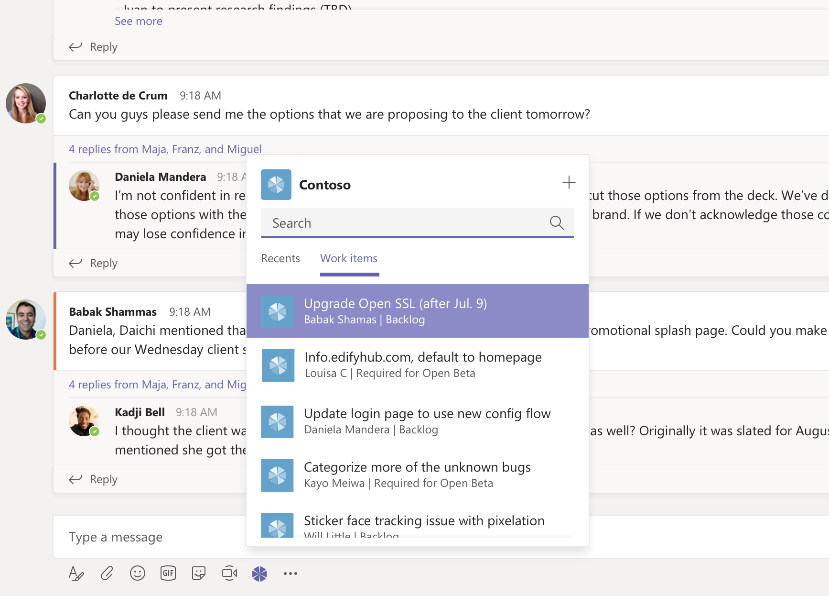
Message Extensions
&
Actions

Slide 30
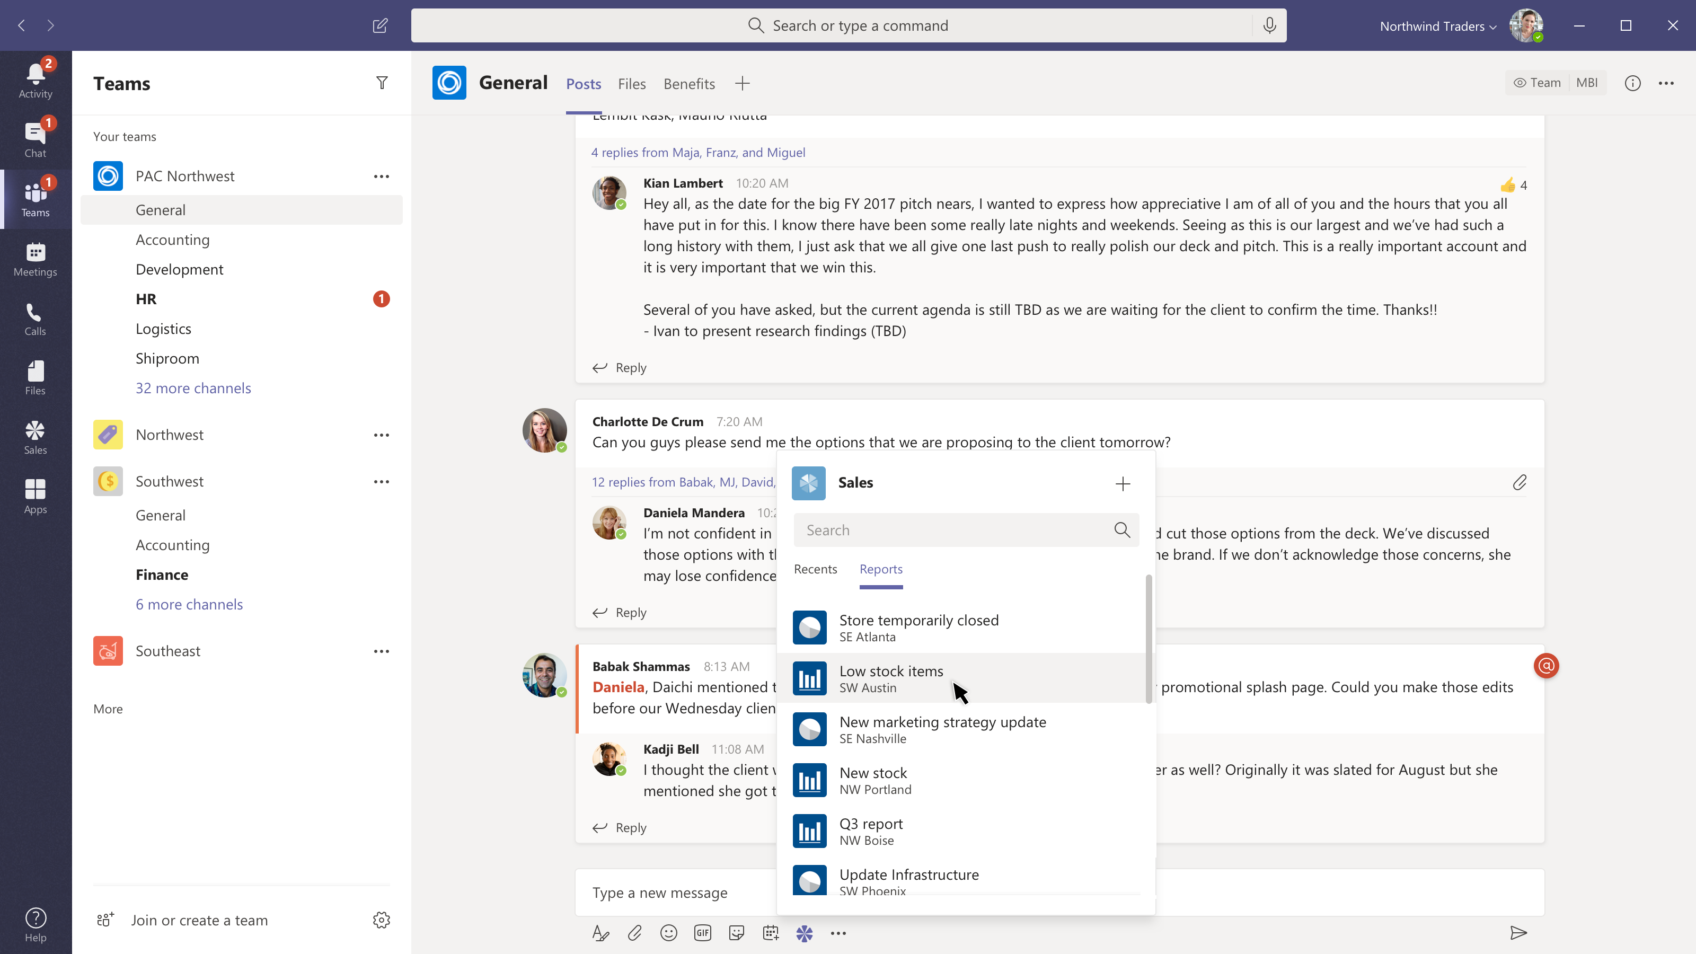
Share a sales report
Message extensions
Search for or show recently viewed reports.

Slide 31
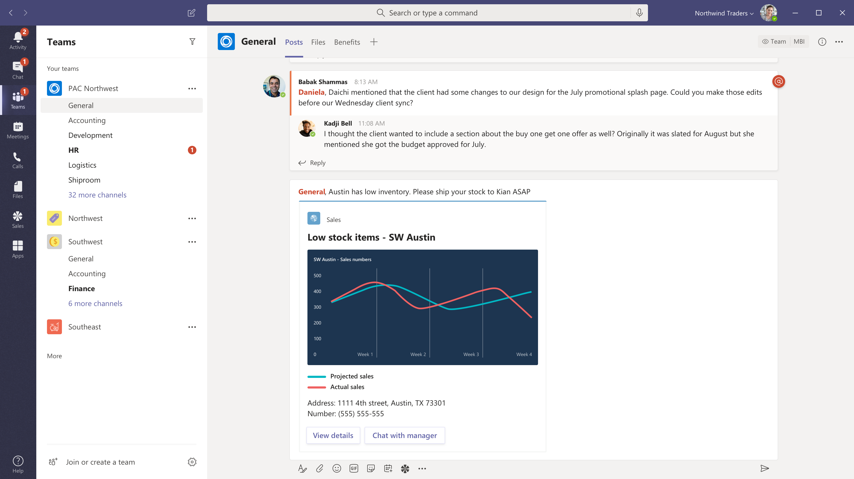
Share a sales report
Message extensions
Search for or show recently viewed reports.
Compose with card
Add comments and @mention the people who need to see the information.

Slide 32
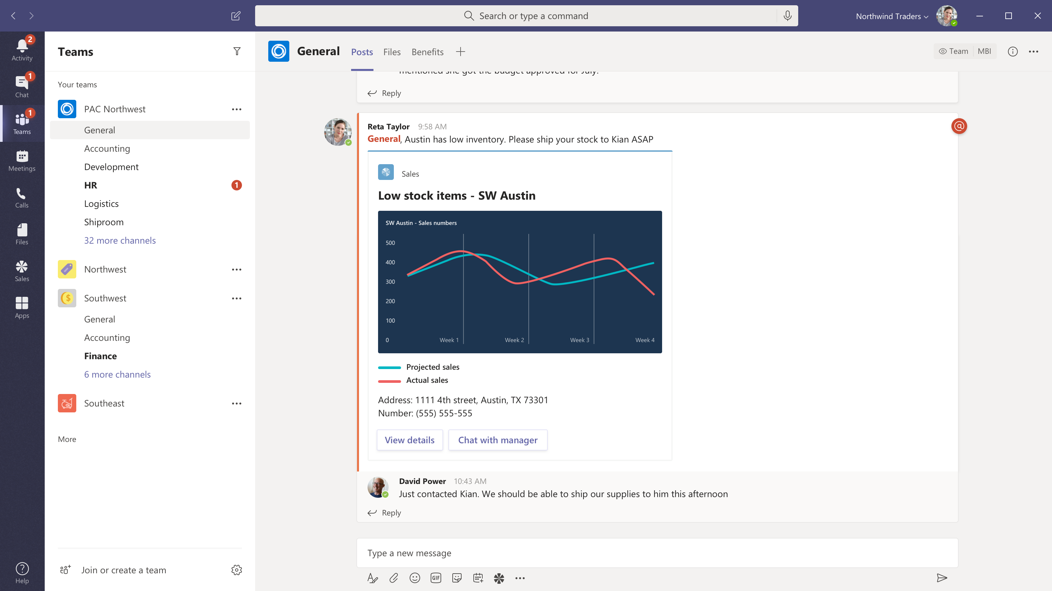
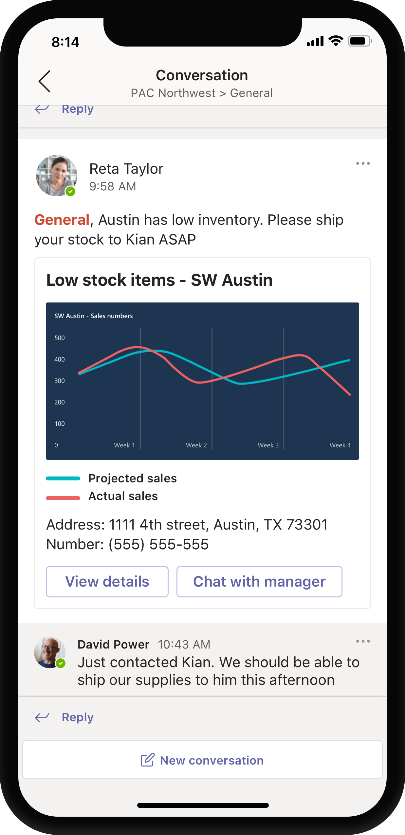
Share a sales report
Message extensions
Search for or show recently viewed reports.
Compose with card
Add comments and @mention the people who need to see the information.
Share to team
Now everyone can see the summary, open a link to your content or take immediate action right from the chat.

Slide 33
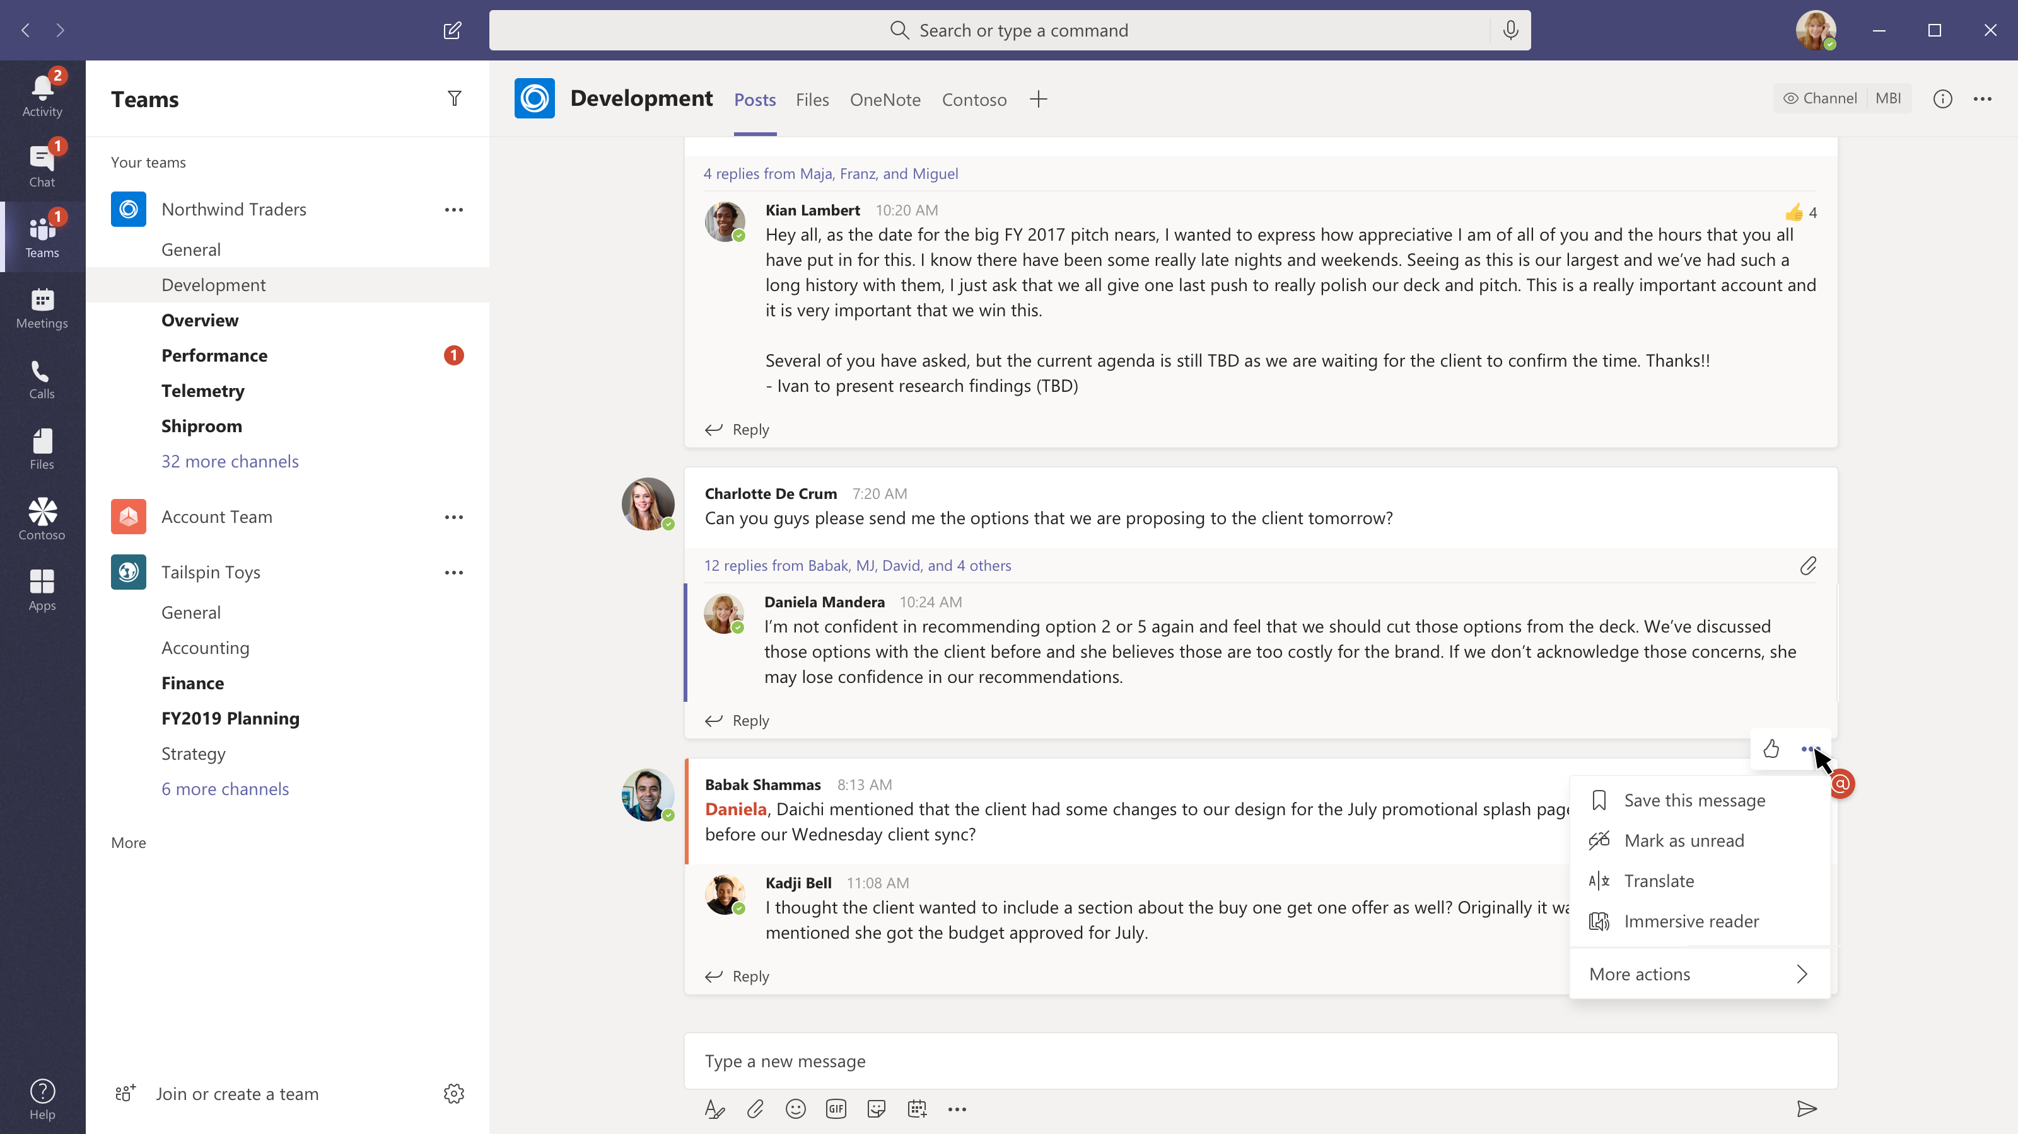
Convert chat to a sales opportunity
Message actions
Your users can send chats to your service and include time, sender information, text and if you use graph chats above and below the selection for additional context.

Slide 34
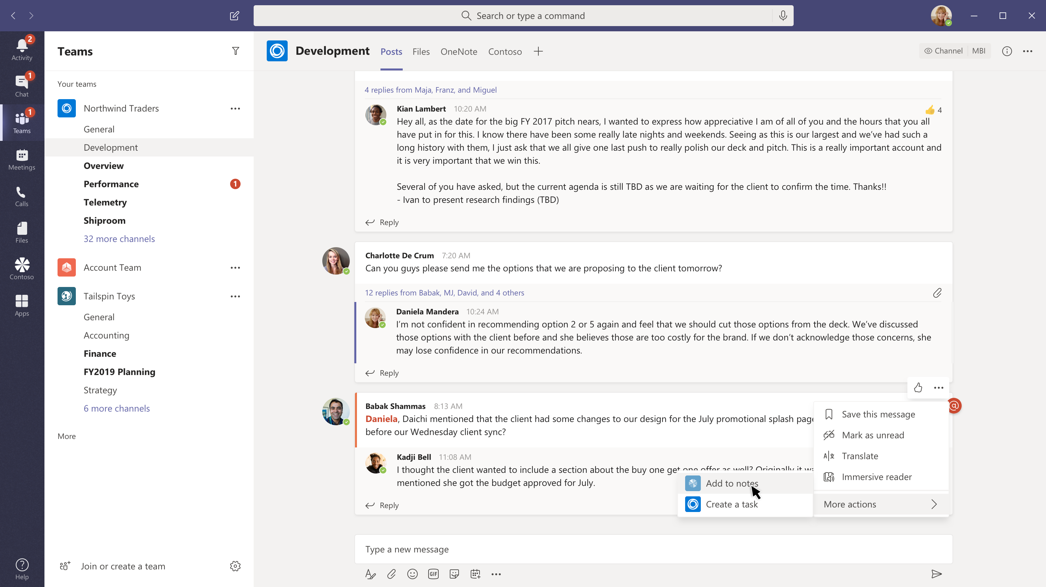
Convert chat to a sales opportunity
Message actions
Your users can send chats to your service and include time, sender information, text and if you use graph chats above and below the selection for additional context.
Tasks where the conversation is happening
Create one or more actions that appear in our context menus.

Slide 35
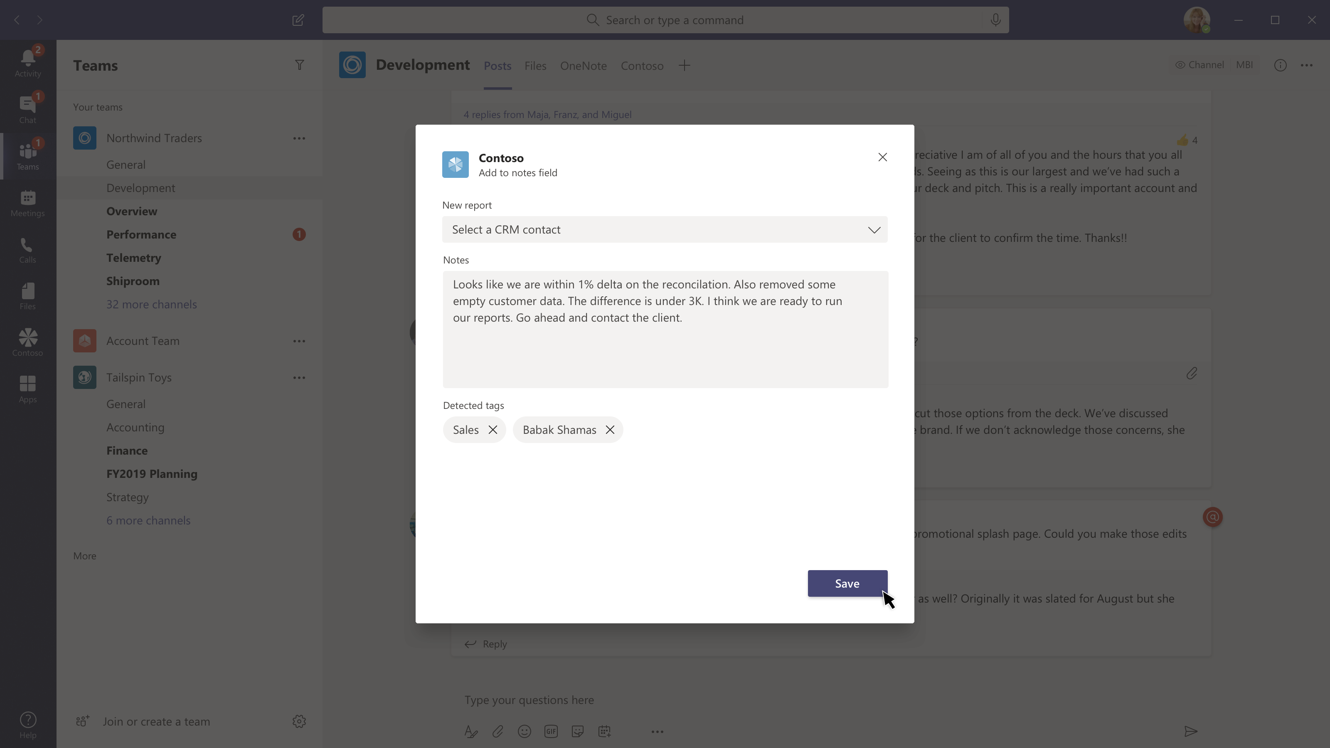
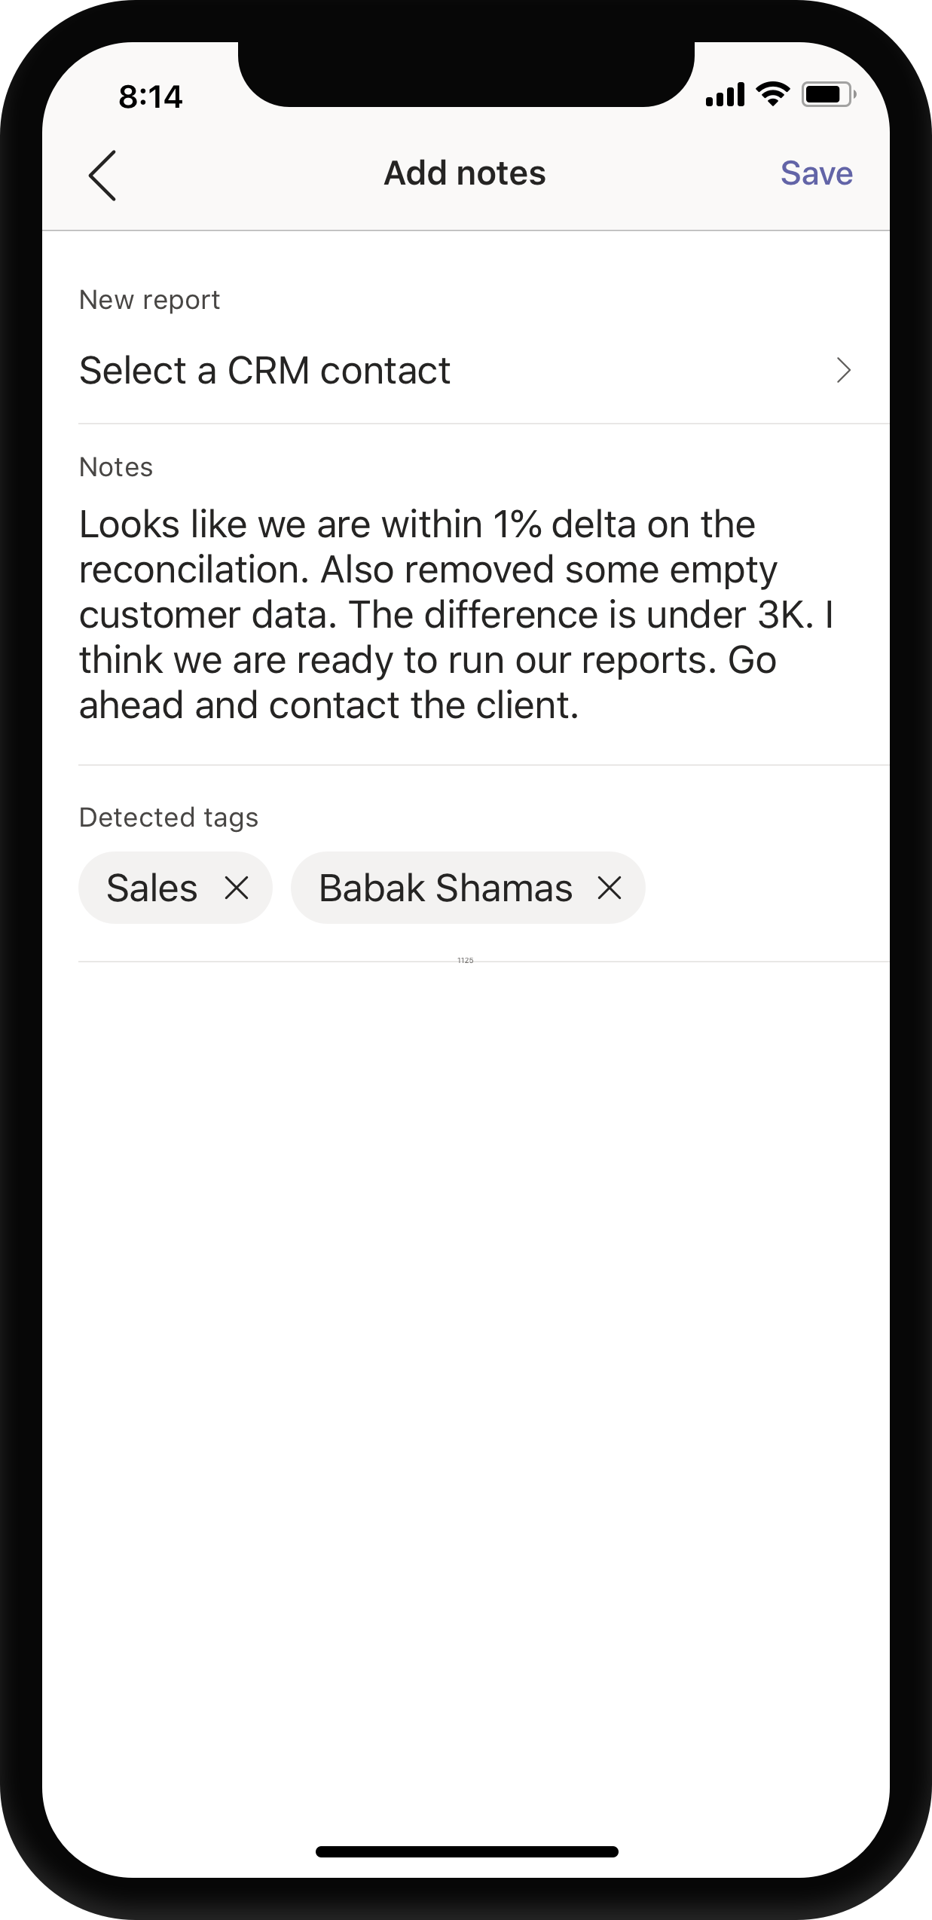
Convert chat to a sales opportunity
Message actions
Your users can send chats to your service and include time, sender information, text and if you use graph chats above and below the selection for additional context.
Tasks where the conversation is happening
Create one or more actions that appear in our context menus.
Confirm with a task module
Keeping the user in control but using natural language processing to extract the words you need to get the job done quickly and intelligently.

Slide 36
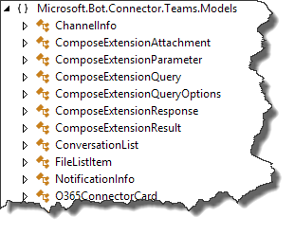
Events and Queries
Edit Master text styles
Second level
Third level
Fourth level
Fifth level

Slide 37
Events and Queries
Query events
Query data sent to bot
Activity.GetComposeExtensionQueryData()
Verify commandId and parameters
Use parameter value to query your service
Respond with attachment layout of “List”
Adaptive Card
Hero Card
Thumbnail Card
O365Connector Card

Slide 38
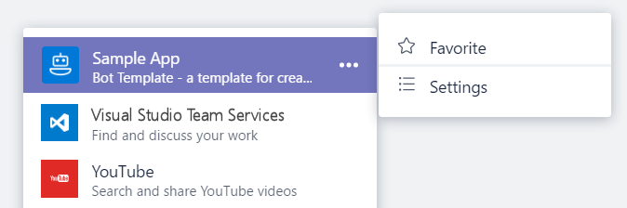
Events and Queries
Settings events
If canUpdateConfiguration is true, Teams will send Settings events in response to user action
onQuerySettingsUrl
Sent when “Settings” clicked
Return Url of settings page
Teams will render page
onSettingsUpdate
Sent when settings page is closed
Storage of settings is developer responsibility

Slide 39
Responding to User Requests
Service must respond within 5 seconds.
Response is not an activity sent via the Bot Framework.
Response is an HTTP Response:
HTTP Status of 200
Content type application/json
Response body must contain a valid composeExtension object.

Slide 40
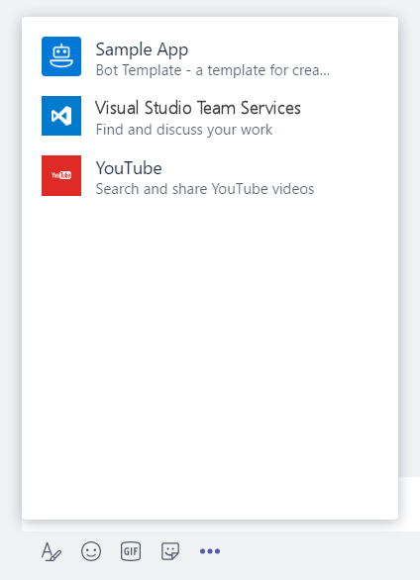
Message Extensions in App Manifest
"composeExtensions": [ { "botId": "[MicrosoftAppId]", "scopes": [ "team" ], "canUpdateConfiguration": true, "commands": [ { "id": "searchCmd", "description": "Search Bot Channels", "title": "Bot Channels", "initialRun": false, "parameters": [ { "name": "searchText", "description": "Enter your search text", "title": "Search Text“ } ] } ] } ]
composeExtension node
Associated with a registered application
Personal and Team scopes
Define command UI and parameter
Multiple extensions
Your extension shown along with all others added to Teams
Notes:
commandExtension is part of the manifest.json file
Scope determines if 1:1 (personal) or channel (team)

Slide 41
Creating Message Action from Extension
"composeExtensions": [
{
"botId": "57a3c29f-1fc5-4d97-a142-35bb662b7b23",
"canUpdateConfiguration": true,
"commands": [
{
"id": "reassignTodo",
"description": "Reassign a todo item",
"title": "Create To Do",
"type": "Action",
"context": ["message"],
"fetchTask": true
}]

Slide 42
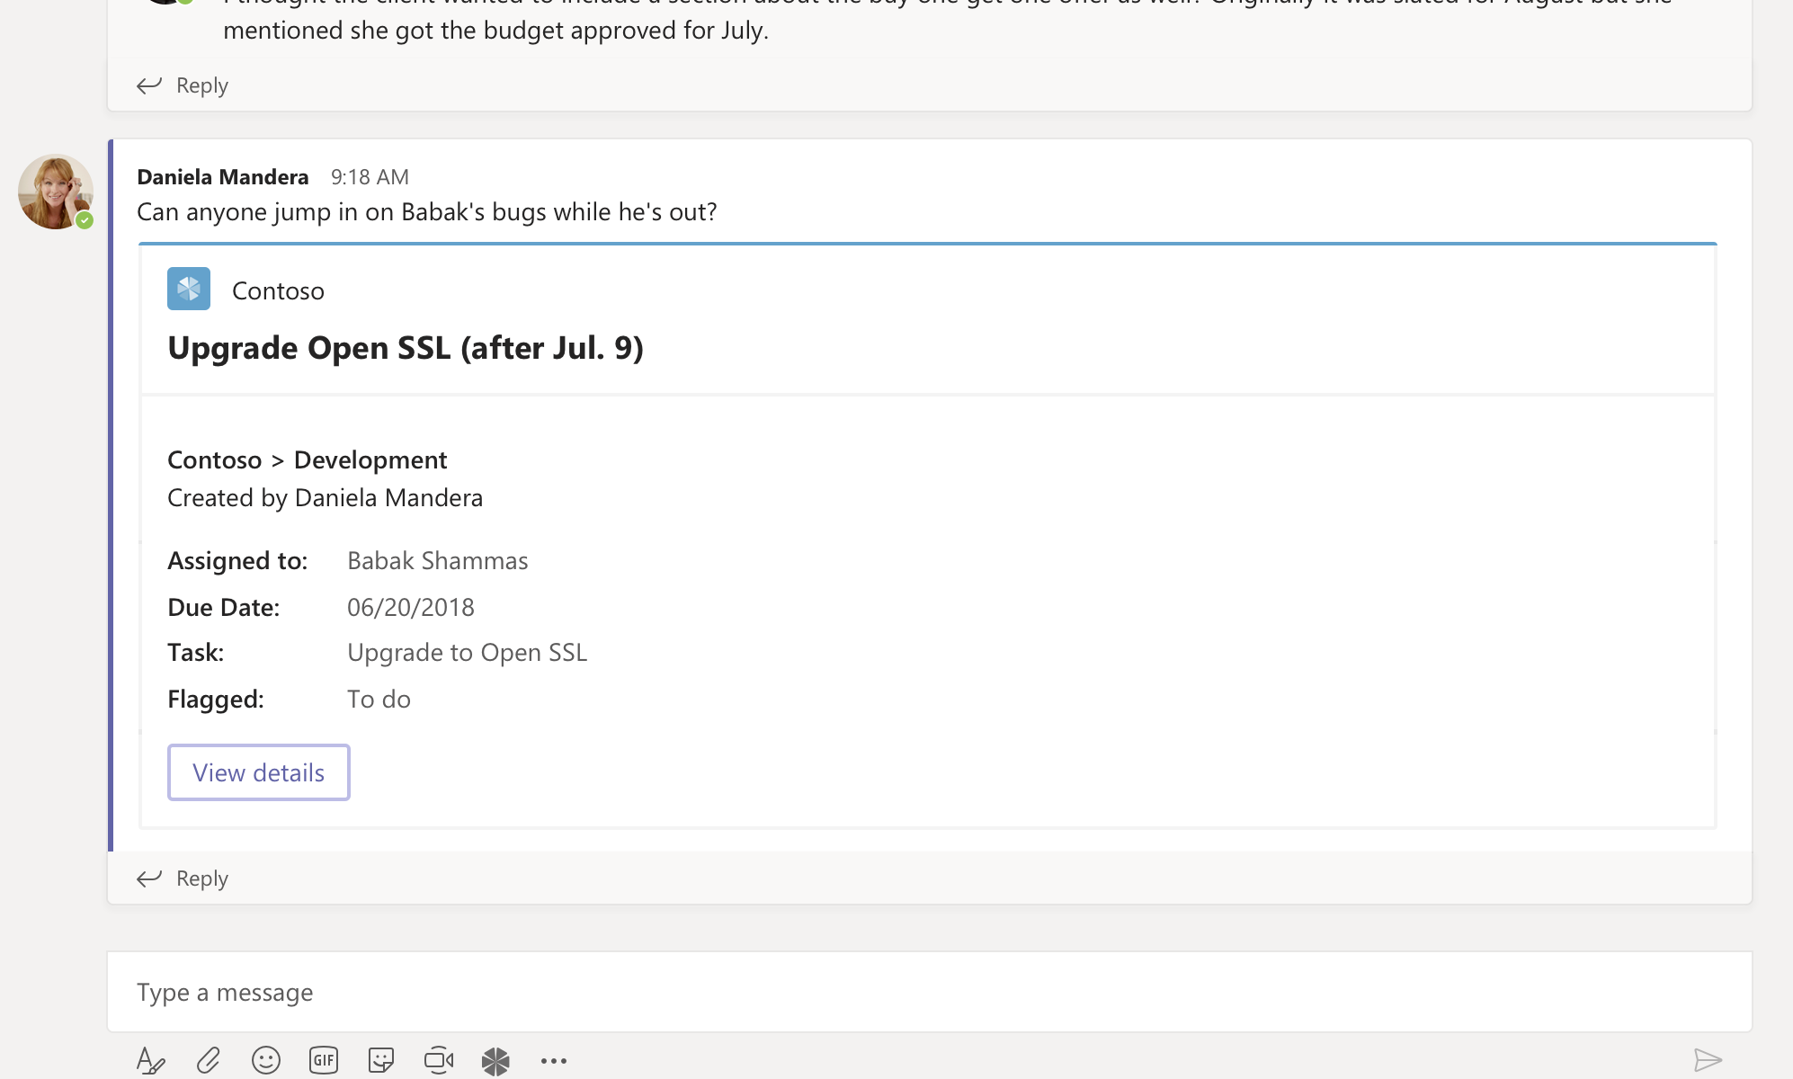
Demo & Hands-on Message Extension & Actions
Lab 1
Register a new bot in Microsoft Azure
Exercise 1 - Create action command messaging extensions using yo Teams
Exercise 2 - Create search command messaging extensions
Exercise 3 - Implement link unfurling messaging extensions

Slide 43
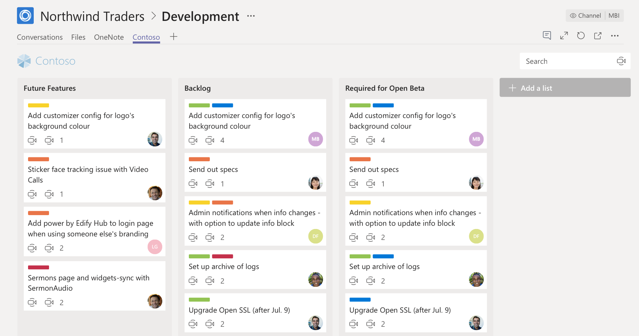
Tabs

Slide 44
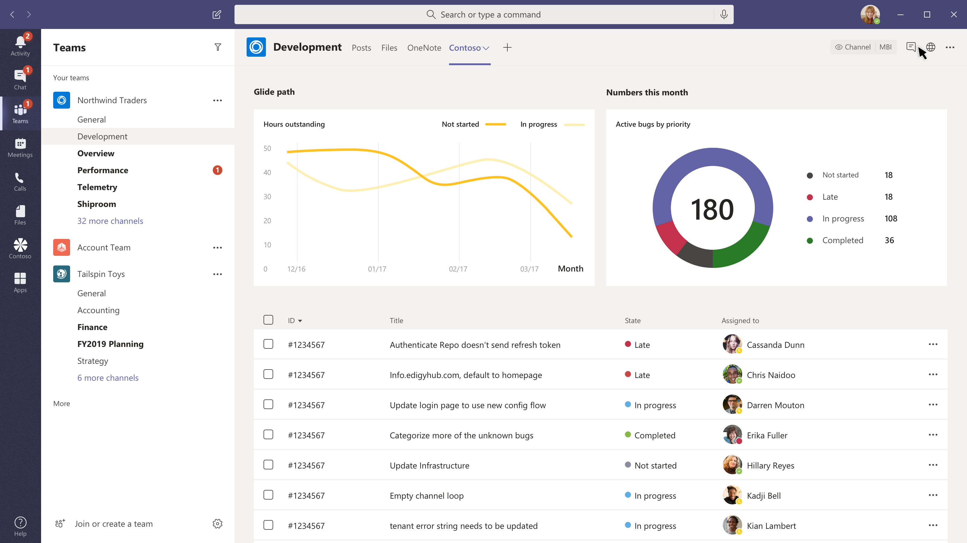
Have a conversation about work items
Tabs
When your app needs a large area to present information to users a tab is a great place to show a list of work items or a dashboard

Slide 45
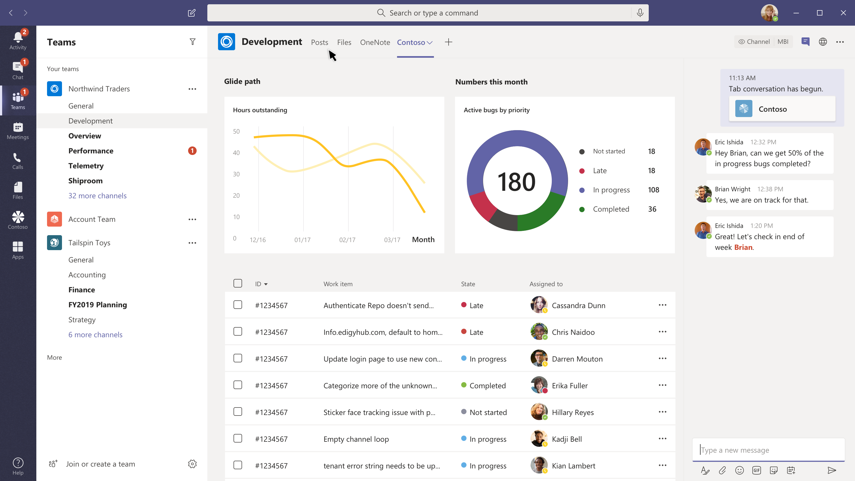
Have a conversation about work items
Tabs
When your app needs a large area to present information to users a tab is a great place to show a list of work items or a dashboard
Chat in context
Users can chat about your page, interact with it and draw people’s attention to important information all in one place

Slide 46
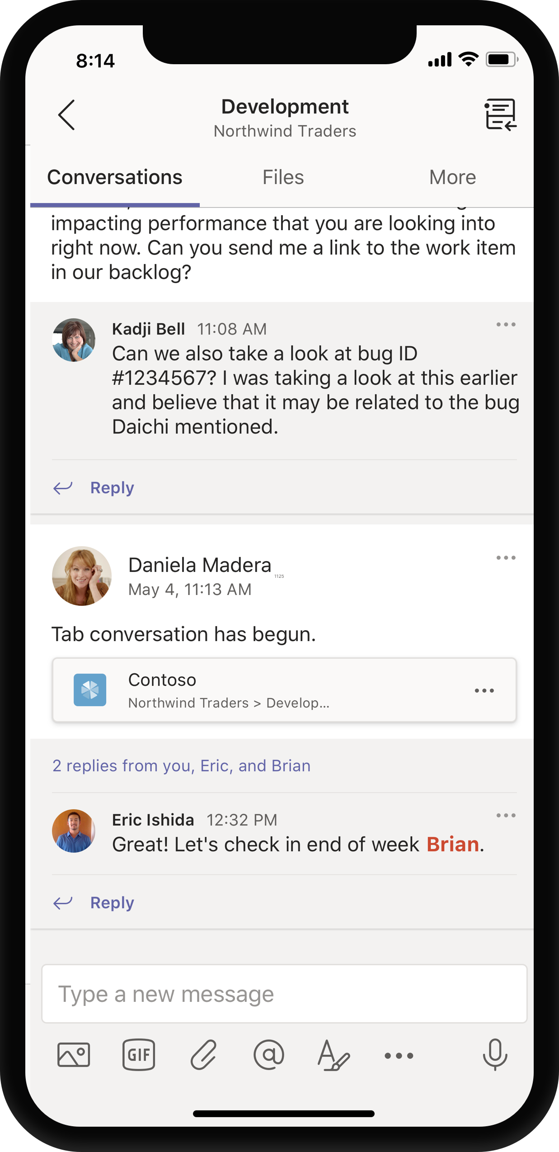
Have a conversation about work items
Tabs
When your app needs a large area to present information to users a tab is a great place to show a list of work items or a dashboard
Chat in context
Users can chat about your page, interact with it and draw people’s attention to important information all in one place
Post tab threads
Conversations within the tab will be posted in the team’s channel and promote your tab

Slide 47
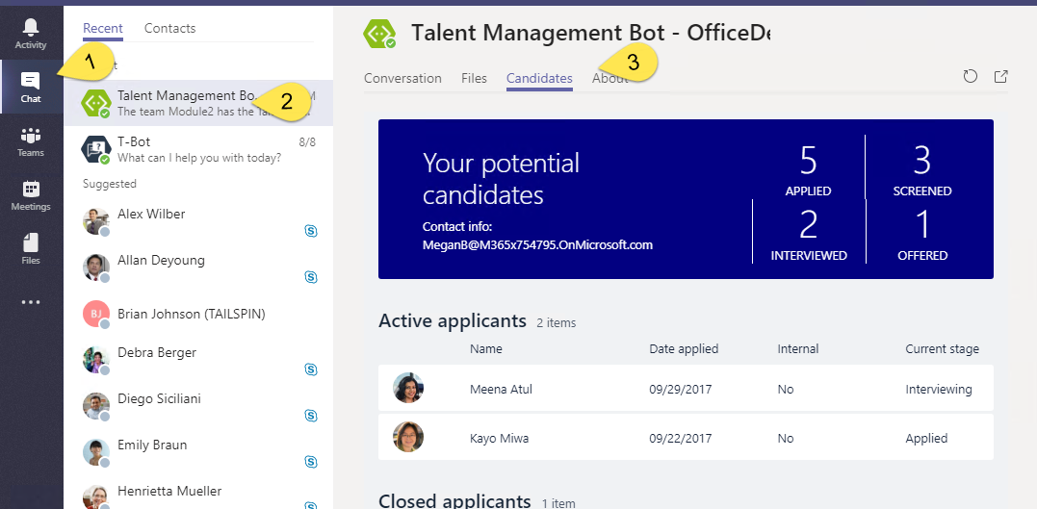
Static Tabs
A content page declared directly in manifest
No Configuration
Added in “personal” scope
Accessed via the app bar or alongside bot conversation

Slide 48
Static Tabs - Manifest
"staticTabs": [ { "entityId": "candidatesTab", "name": "Candidates", "contentUrl": "https://.../Tabs/candidates.html", "websiteUrl": "https://.../Tabs/candidates.html?web=1", "scopes": [ "personal" ] } ],
"validDomains": [ "token.botframework.com" ]
staticTabs node
contentUrl is hosted in IFRAME in Teams
websiteUrl is used as target for link
validDomains node
A list of valid domains from which the extension expects to load any content.

Slide 49
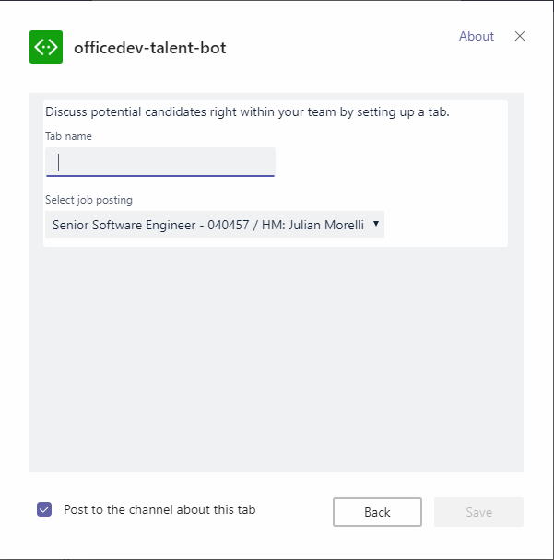
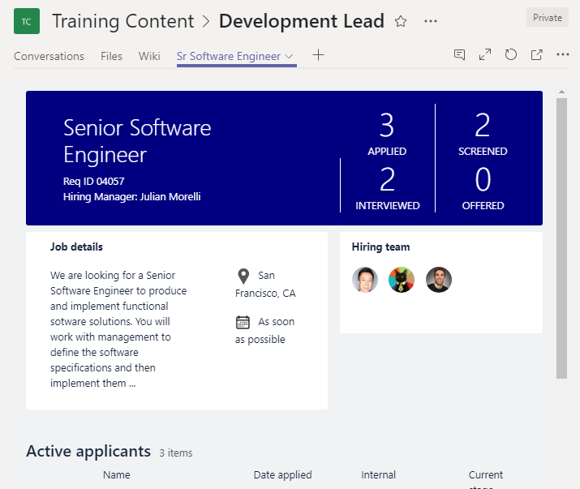
Tab Configuration and Content
Tab Configuration
Configured in manifest
Displayed when Tab added to Channel
Collect information
Call setSettings() specifying Content Url and Entity Id
Tab Content
Rendered in IFRAME
Url specified by configuration page
Inspect context for EntityId/SubEntityId
Retrieve state based on Entity/SubEntity/User
Notes:
To provide a seamless tab experience, perform provisioning and authorization on configuration page when possible.
If context has entity/subentity, then respond to a deeplink
State storage is developer’s responsibility

Slide 50
Demo & Hands-on Tabs
Lab 2
Exercise 1 - Create a custom Microsoft Teams personal tab
Exercise 2 - Create a custom Microsoft Teams channel or group tab
Exercise 3 - Implement authentication in a custom tab

Slide 51
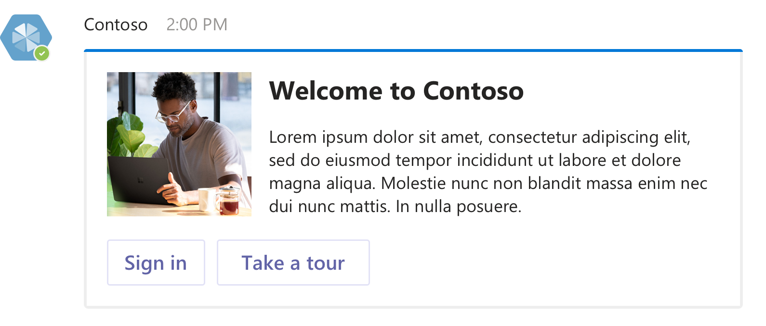
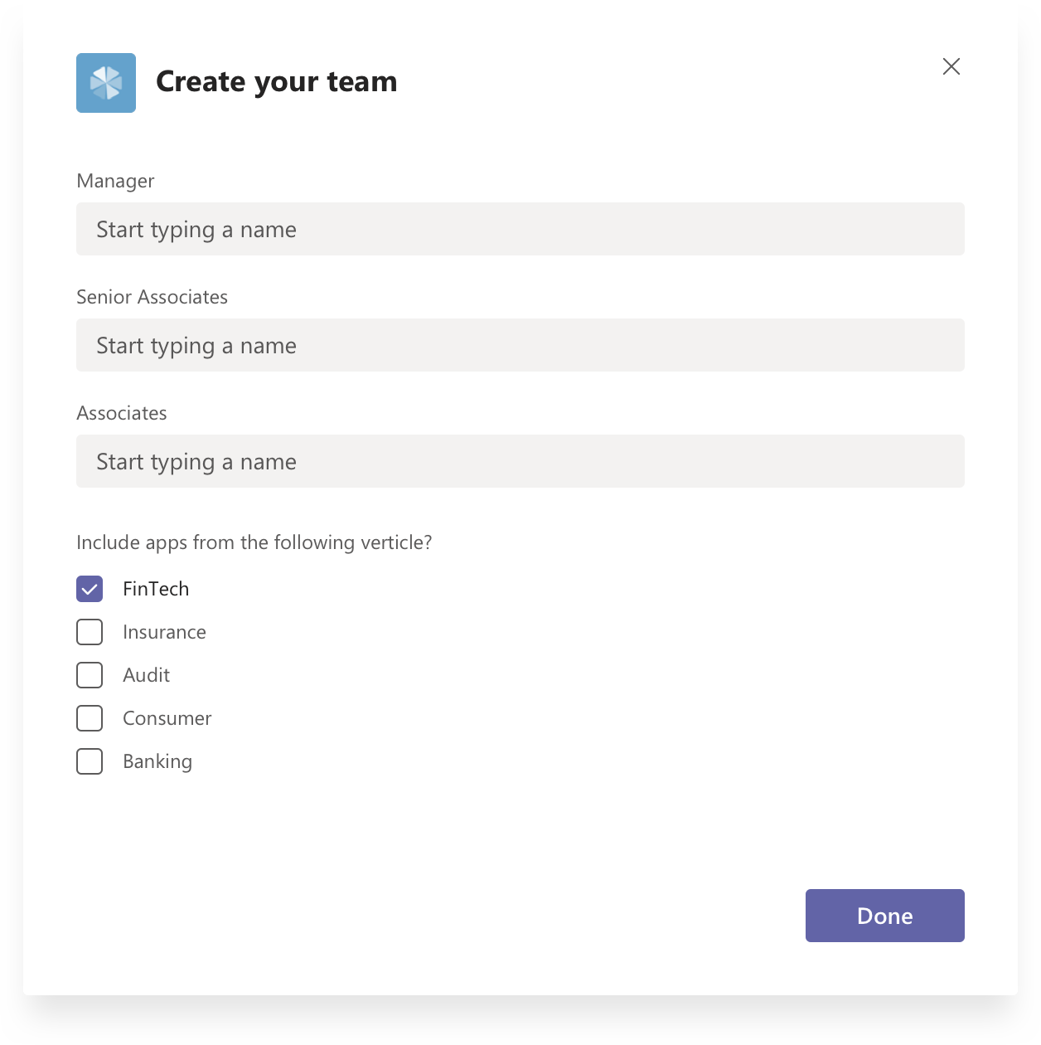
Bots & Task Modules

Slide 52
Conversations
Series of messages sent between your bot and one or more users. Conversations are in one of the following scopes:
Teams
Also called channel conversations, visible to all members of the channel.
Personal
Conversations between bots and a single user.
Group chat
Chat between a bot and two or more users.

Slide 53
Bot Events in Microsoft Teams
Activity objects are used to pass information back and forth between bot and channel (or user). Activities can represent Events, denoted by ActivityType == ‘conversationUpdate’
Team Member Events
teamMemberAdded
teamMemberRemoved
Payload object contains added/removed members
*Adding bot fires this event
Channel Events
channelCreated
channelRenamed
channelDeleted
ChannelData object reflects current state
Team Events
teamRenamed
ChannelData object reflects current state
Reactions
reactionsAdded
reactionsRemoved
replyToId contains the ID of the specific message
Notes:
Teams will send notifications to your bot for changes or events that happen in contexts where your bot is active. You can use these events to trigger service logic, such as:
Trigger welcome message when your bot is added to a team.
Query and cache team information when the bot is added to a team.
Updated cached information on team membership or channel information changes.
Remove cached information for a team if the bot is removed.
Since bot is scoped to team, no events for team creation/deletion provided.
When bot is added/removed, TeamMember events are sent.

Slide 54
Teams Context
Your bot can access additional context about the team or chat, such as user profile. This information can be used to enrich your bot's functionality and provide a more personalized experience.
Members in conversation
var mbrs = await connector.Conversations .GetConversationMembersAsync(
message.Conversation.Id );
foreach (var mbr in mbrs.AsTeamsChannelAccounts())
{
[...]
}
Channels in Team
ConversationList channels = client .GetTeamsConnectorClient() .Teams .FetchChannelList( activity.GetChannelData<TeamsChannelData>() .Team.Id );
Notes:
Use the Microsoft.Bot.Connector.Teams package to get extension methods for Microsoft Teams. Handles the parsing of the Bot Framework payload with Teams-specific functionality.

Slide 55
Proactive Messaging
A proactive message is an activity sent by a bot to start a conversation
Start Personal conversation
Must have user’s information cached
From team roster
From previous interaction with user
From conversationUpdate events
Use the CreateOrGetDirectConversation method
Start Channel conversation
Must have channel information cached
From previous interaction in channel
From conversationUpdate events
To create conversation:
Create ConnectorClient with service Uri
Call connector.Conversations.CreateConversationAsync, passing channel account for bot
Set Conversation property of new message
Call connector.Conversations.SendToConversationAsync
Notes:
Personal conversation requires User Id (from Teams) and Tenant Id

Slide 56
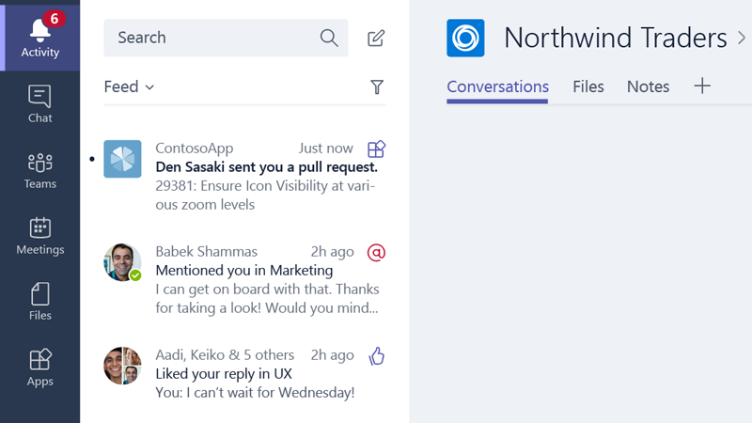
Activity Feed
Optionally send personal chat messages into the feed as preview cards summarizing your app's activity.
Construct the message such that choosing the card navigates the user straight to the message or object that triggered the notification, such as an entity in a tab.
Must include Text and Summary properties

Slide 57
Notification only bots
"bots": [ { "botId": "[MicrosoftAppId]", "scopes": [ "personal", "team" ], "isNotificationOnly": true, } ]
Bots can update the activity feed
If the sole purpose of the bot is to deliver notifications, consider a notification only bot.
Users cannot message your notification-only bot
Users cannot @mention the bot
bots node
isNotificationOnly property

Slide 58
Send and Receive file
Sending and receiving files through a bot can be accomplished via two different APIs
Microsoft Graph API
Obtain access to OneDrive folder (user or group drive)
Get reference to file
Post message to conversation with card attachment
Microsoft Teams API
Personal context (1:1) only
Enable files in manifest
Teams client provides a file picker experience
Teams client will store file in OneDriveCreate and then post activity with metadata, including content URL
Bot must download and handle file as appropriate
Notes:
Personal conversation requires User Id (from Teams) and Tenant Id

Slide 59
Enable send and receive
"bots": [ { "botId": "[MicrosoftAppId]", "scopes": [ "personal", "team" ], "supportsFiles": true, } ]
Teams client will handle file selection and storage
Handles scenario User -> Bot
bots node
supportsFiles property

Slide 60
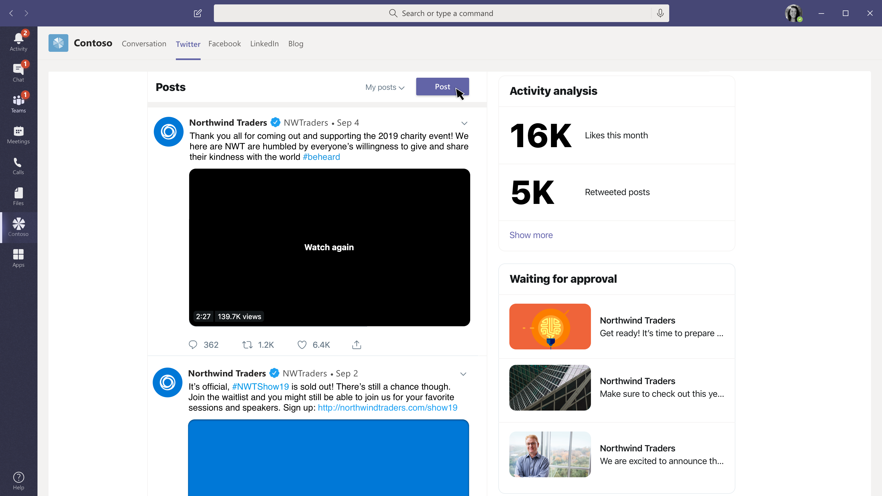
Submit a social media post for approval
Social media dashboard
A great view of my company’s social media engagement and how we are trending

Slide 61
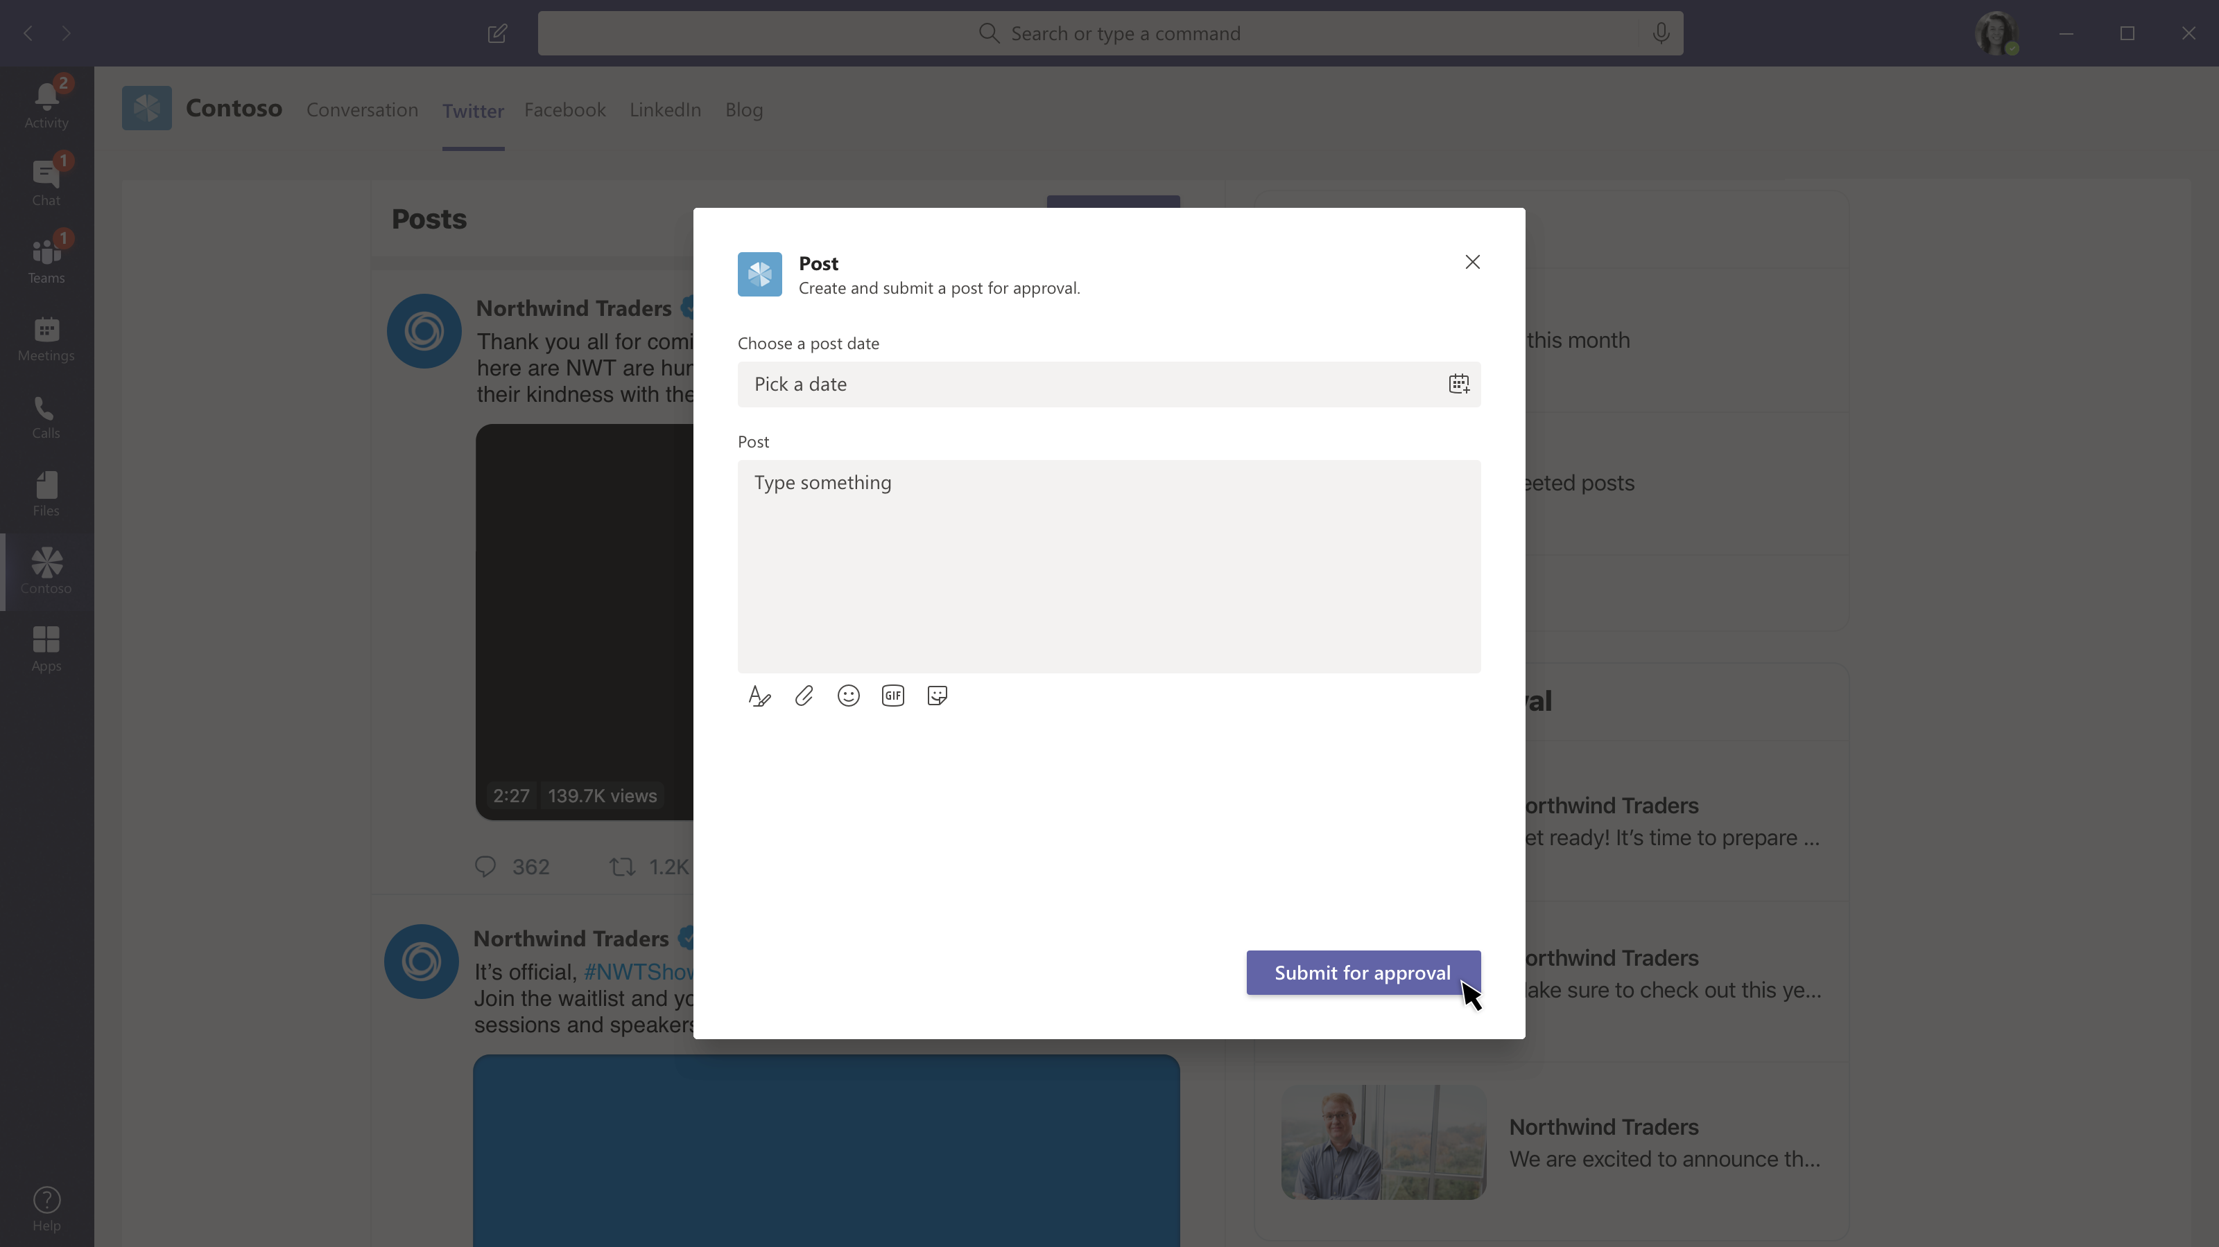
Submit a social media post for approval
Social media dashboard
A great view of my company’s social media engagement and how we are trending
Submit a post for approval
Approval workflows get routed to the right team for quick review and automated posting to your corporate social media accounts

Slide 62
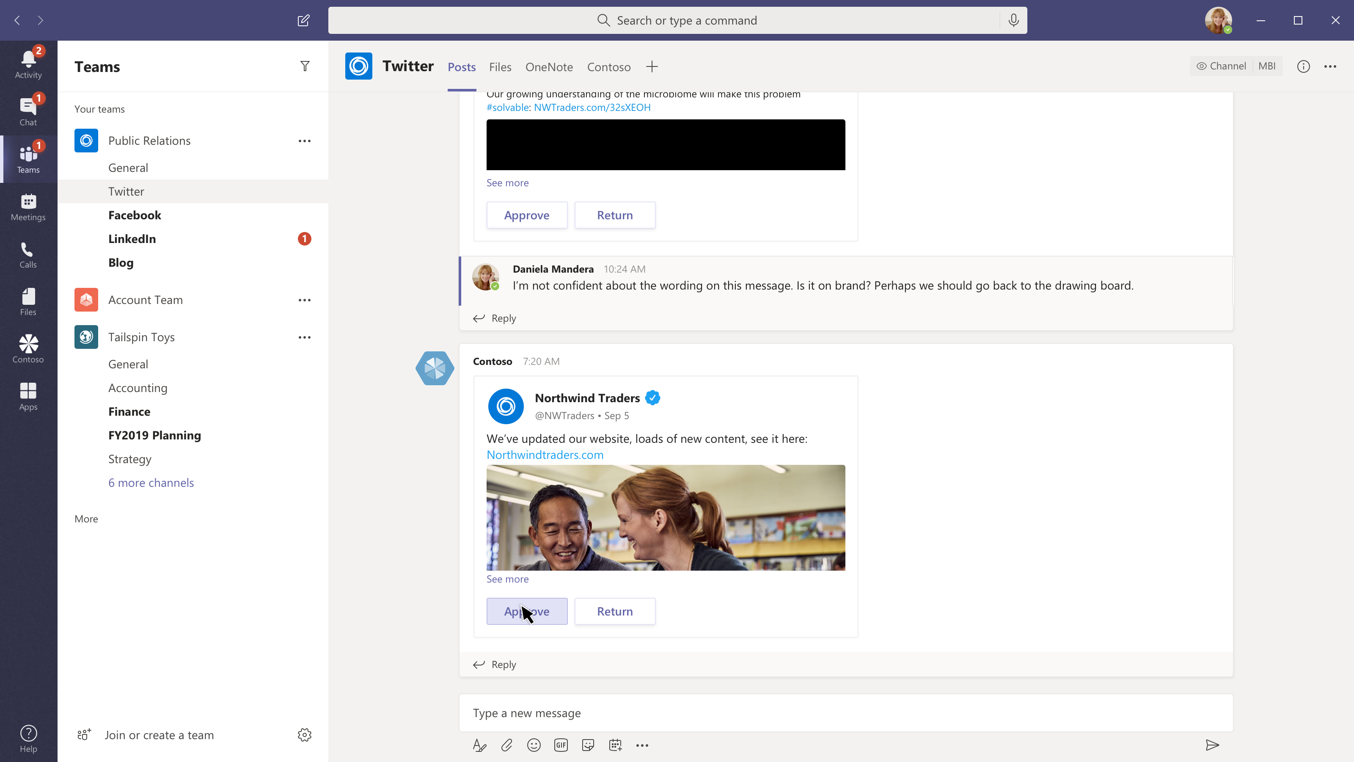
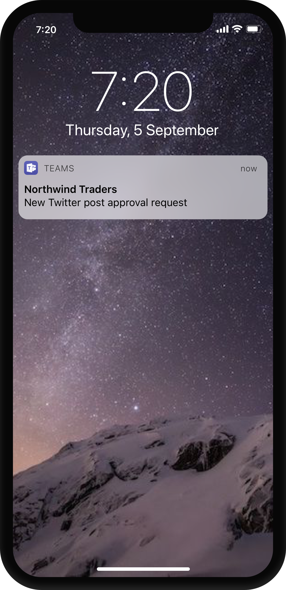
Submit a social media post for approval
Social media dashboard
A great view of my company’s social media engagement and how we are trending
Submit a post for approval
Approval workflows get routed to the right team for quick review and automated posting to your corporate social media accounts
Notify the right team
Approval workflows get routed to the right team for quick review and automated posting to your corporate social media accounts

Slide 63
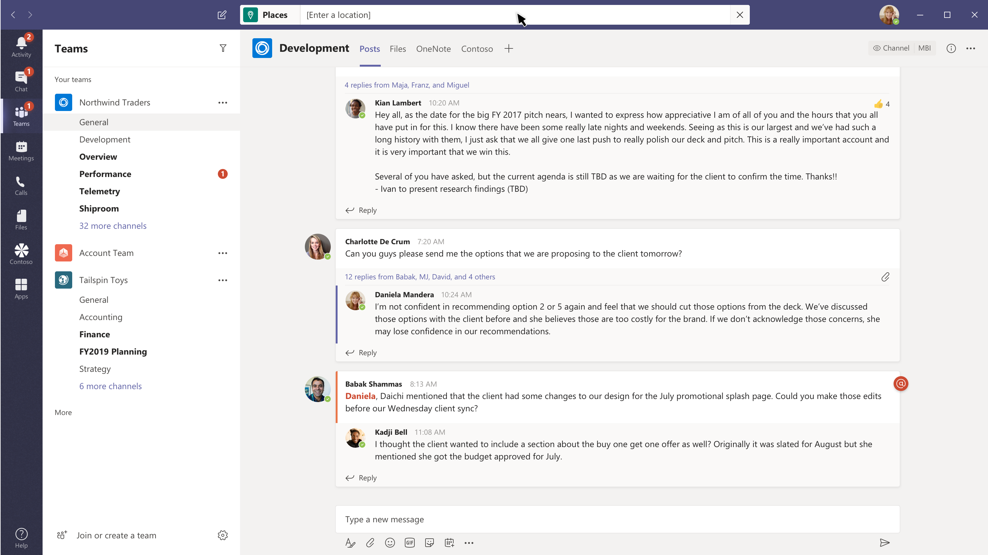
Look up a place to eat
Find a restaurant without losing your place
@mentioning your app in the command box gives users global access to your app, while they are anywhere in teams.

Slide 64
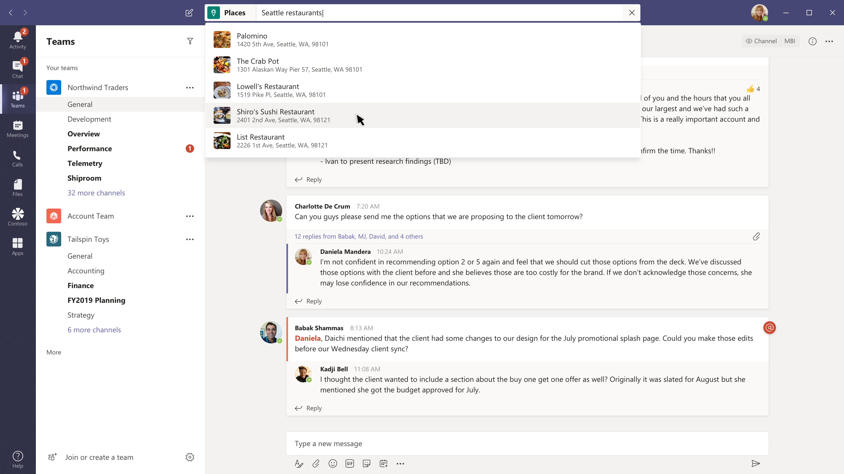
Look up a place to eat
Find a restaurant without losing your place
@mentioning your app in the command box gives users global access to your app, while they are anywhere in teams.
Search with one or more parameters
You can make your app incredibly powerful with single parameter or multi parameter queries, and even default queries you save for everyone or per user.

Slide 65
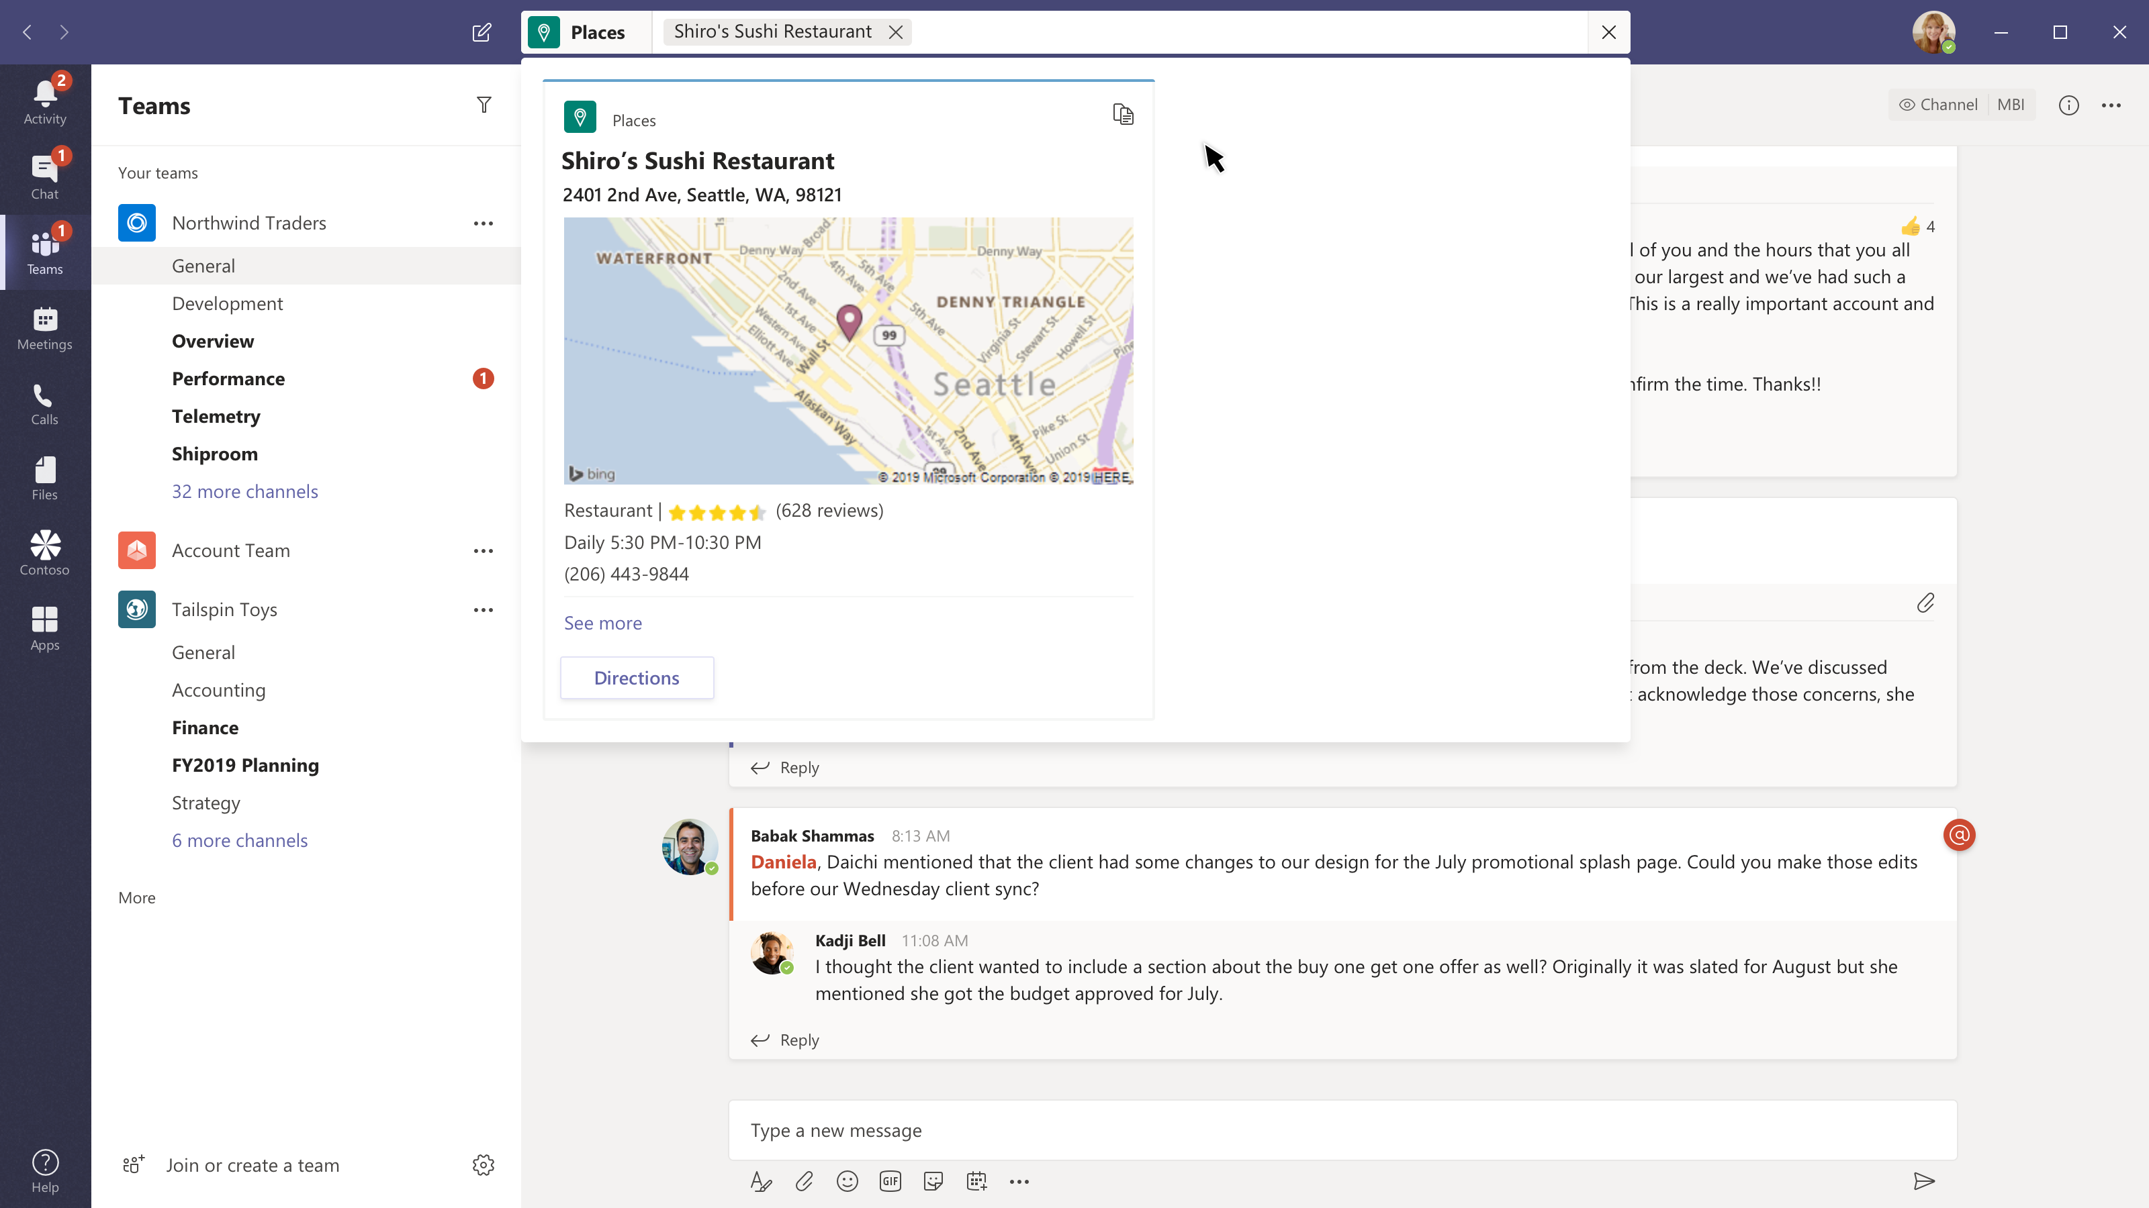
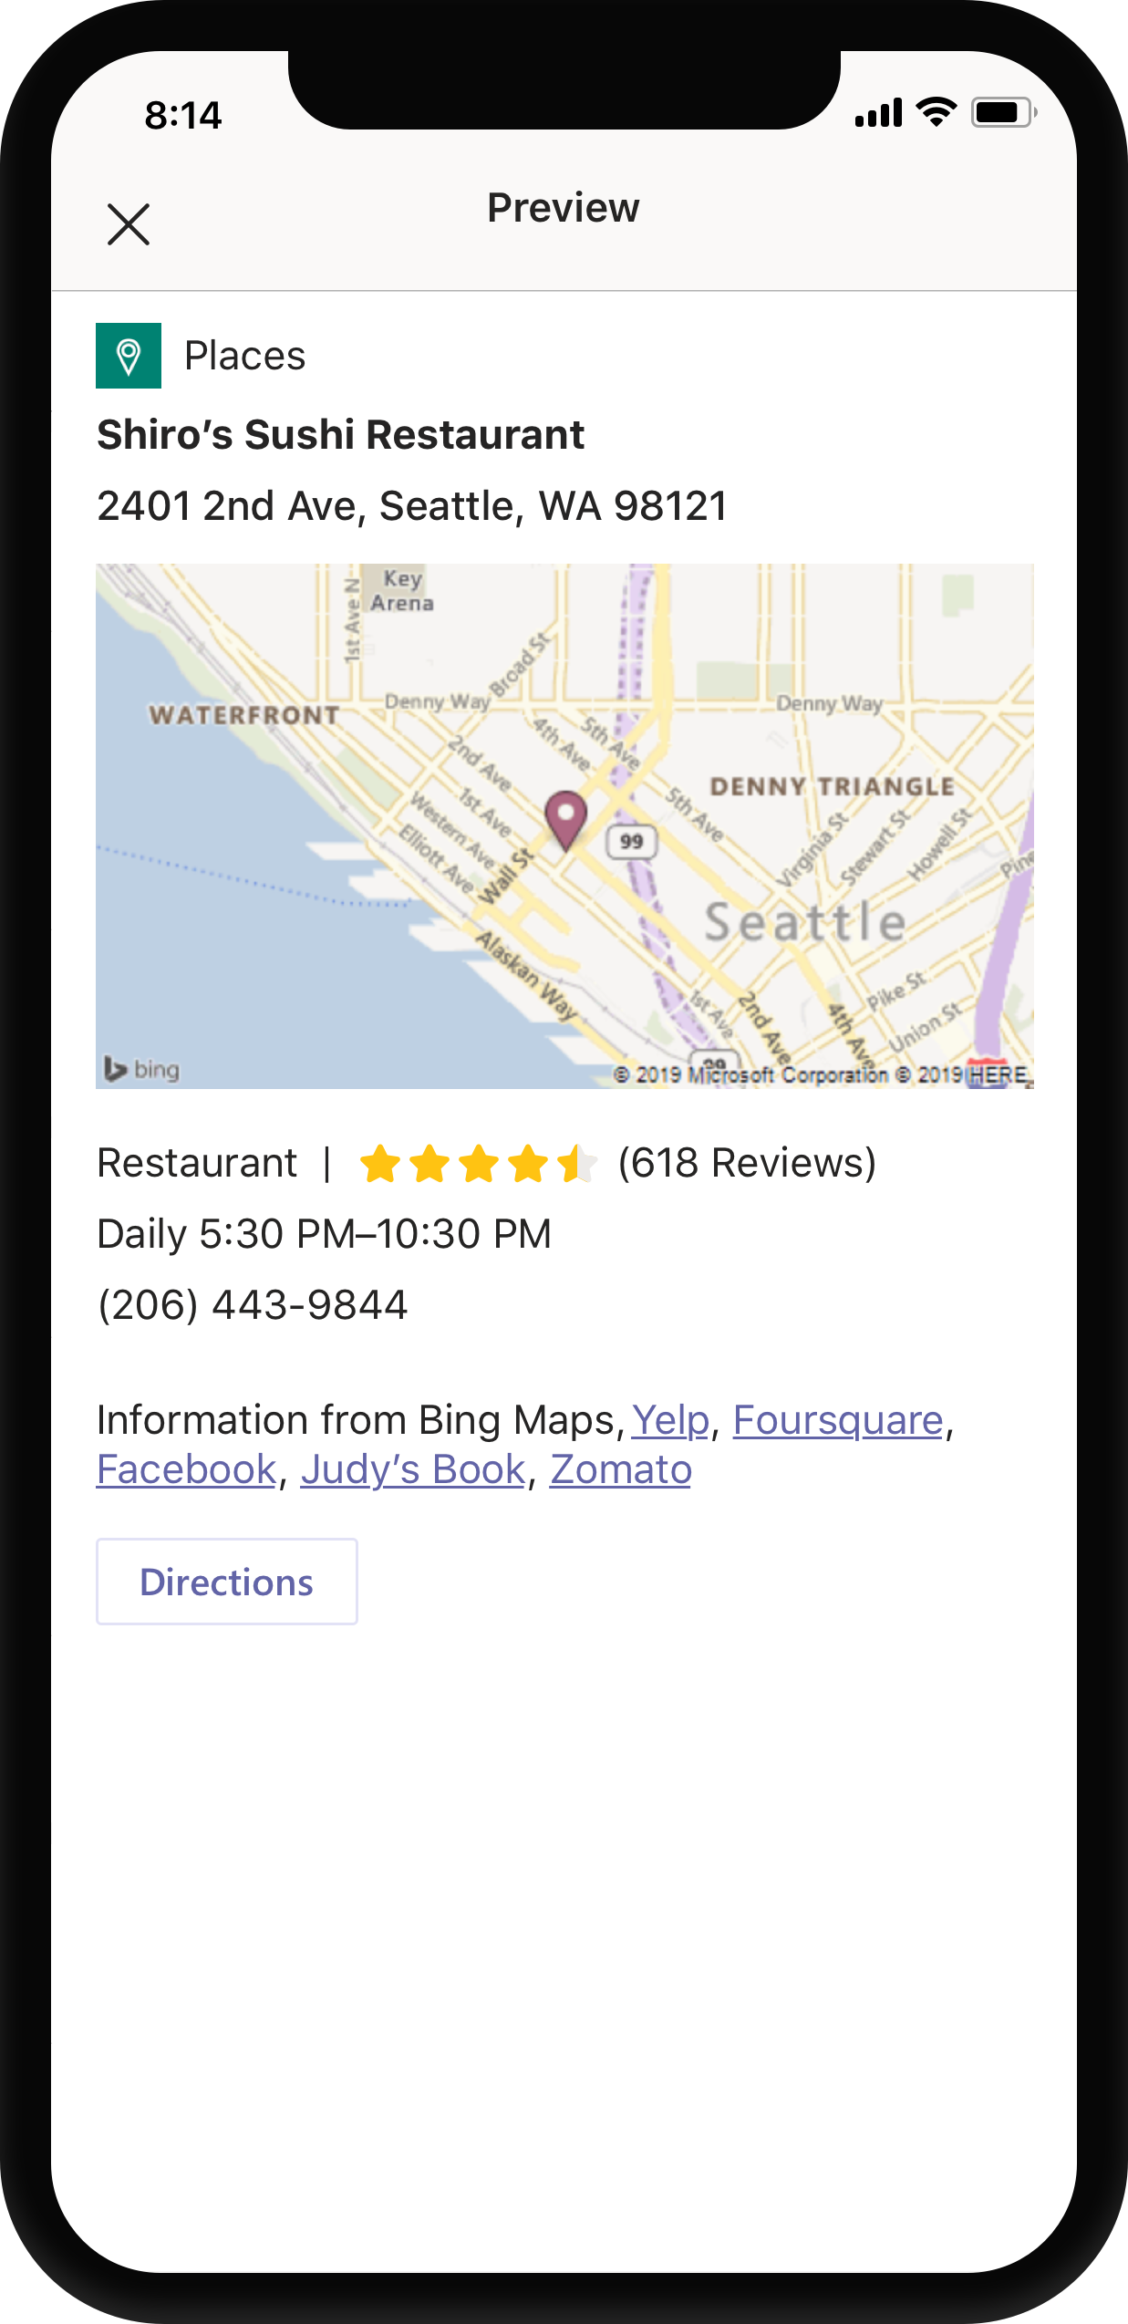
Look up a place to eat
Find a restaurant without losing your place
@mentioning your app in the command box gives users global access to your app, while they are anywhere in teams.
Search with one or more parameters
You can make your app incredibly powerful with single parameter or multi parameter queries, and even default queries you save for everyone or per user.
Share
Users can get the information they need and get back to work or share your card with others.

Slide 66
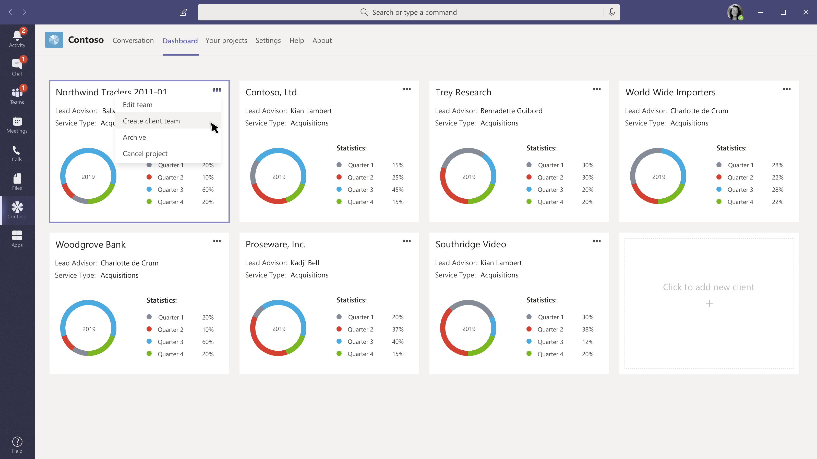
Create a team, add members, and a message
Kicking off a new project can be easier
Using Teams templates and your app you can automate the onboarding process.

Slide 67

Create a team, add members, and a message
Kicking off a new project can be easier
Using Teams templates and your app you can automate the onboarding process.
Simplify known workflows
Select users who will be team owners vs team members to comply with access and role limitations, pick documents in your service or on SharePoint to add to the mix. Add a welcome message.

Slide 68


Create a team, add members, and a message
Kicking off a new project can be easier
Using Teams templates and your app you can automate the onboarding process.
Simplify known workflows
Select users who will be team owners vs team members to comply with access and role limitations, pick documents in your service or on SharePoint to add to the mix. Add a welcome message.
Bot notification
In the new team we start the project knowing what we are doing and where everything is.

Slide 69

Your “task” hub
The Development channel has some tasks for Daniella
This is a project with specific goals and work items.

Slide 70

Your “task” hub
The Development channel has some tasks for Daniella
This is a project with specific goals and work items.
The Marketing channel is in another team
But Daniella has things she needs to do here too.

Slide 71


Your “task” hub
The Development channel has some tasks for Daniella
This is a project with specific goals and work items.
The Marketing channel is in another team
But Daniella has things she needs to do here too.
Personal apps can create a unified view
Daniella will likely start her day here, and it’s a great place to see all the work she has to do in one place… with handy links to take her to the channels where she needs to collaborate

Slide 72

Demo & Hands-on Teams Tab

Slide 73
Microsoft Graph
a unified REST API
and comprehensive developer experience
for integrating the data and intelligence
exposed by Microsoft services.
Notes:
Most of you came to this conference because you have real customers that have data in Microsoft Services. Microsoft Graph is the way to access that data.

Slide 74

Integrate Microsoft Graph into your app
https://graph.microsoft.com
Team
Group
Channel
Chat
Tabs
App
Create
Get
Update
Delete
Clone
Archive
Unarchive
List Joined
List All
Create
Get
Update
Delete
Renew
Create
Add owner
List owners
Add member
List member
Remove member
Create setting
Get settings
List settings
Create
Get
Update
Delete
List
Add
Get
Update
Remove
List
Add
Get
Update
Delete
List
Add
List
Upgrade
Remove
https://graph.microsoft.com/beta
Mail, Calendar,
Contacts and Tasks
Sites and Lists
Drives and Files
Channels, Messages
Tasks and Plans
Spreadsheets
Notes, and more…
Identity Management
Access Control
Synchronization
Domains
Administrative Units
Applications and Devices
Advanced Threat Analytics
Advanced Threat Protection
Alerts
Policies
and more…

Slide 75
Permissions
Two types of permissions:
User delegated permissions for when there is a user present
Application permissions for when there isn't
Teams APIs require Group.Read.All or Group.ReadWrite.All
For user delegated, means all groups the user can read/write
For application permissions, means all groups in the tenant
Admin consent required for both user delegated and application permissions

Slide 76
Graph can automate team lifecycles
Create a team
Archive or delete the team when the time comes
Add members and owners
Send a message
Configure team settings
Add tabs
Add channels
Install apps

Slide 77


Teams + SharePoint Framework

Slide 78


SharePoint Framework
Modern client-side development
Lightweight web and mobile
Supports open source tools & JavaScript web frameworks
Built-in Graph support, Azure Active Directory secured APIs and free hosting on SharePoint
Modern client-side development
Lightweight web and mobile
Supports open source tools & JavaScript web frameworks
Built-in Graph support, Azure Active Directory secured APIs and free hosting on SharePoint
SharePoint Framework
Microsoft Graph
Lists & Files
Cloud Services
Notes:
The SharePoint Framework (SPFx) is a developer toolkit that provides full support for modern client-side SharePoint development, easy integration with SharePoint data, and support for open source tooling. With the SharePoint Framework, you can use modern web technologies and tools in your preferred development environment to build productive experiences and apps that are responsive and mobile-ready from day one. The SharePoint Framework works for SharePoint Online and supports many open-source tools and is Javascript web framework agnostic.
Another key advantage is that, developers can leverage all of SharePoint’s capabilities, including lists, files, security, CDNs, and integration with Microsoft Graph and Azure Active-Directory secured APIs, to deliver full end-to-end applications for their organization. This in-turn helps reduces operational costs and minimizes deployment complexity.
In short: if you’re thinking about building an app as an Enterprise or Office developer, then the SharePoint Framework is the preferred way to do it because it’s free and extremely powerful because it takes care of so much of the plumbing for you.

Slide 79
Current State of the World
SharePoint Extensibility
Build modern SP solutions
Full-trust JavaScript based framework running in the main app
Use modern auth to integrate with Graph
SP add-ins
Provider-hosted based via iframes
Low-trust, end user acquisition model
Distribute via Office Store
Teams Platform
Build apps to custom tailor your teams
Modern embedding via tabs
Enhance integrations via bots, messaging extensions, Adaptive cards, and Graph
Add communication services, e.g. programmable voice and video

Slide 80
Top 10 reasons SPFx in Teams rocks
10
No need to host a web site or page
Reuse code in Teams and SharePoint
Azure AD single sign-on built in
SharePoint handles the configuration page
You know what Team and Channel you’re in with the Teams SDK
Easy access to Microsoft Graph, SharePoint APIs
Store data in the Office 365 group
Manage apps centrally in SharePoint Admin Center
Deep linking allows passing context
SharePoint Community

Slide 81
Common needs
Information the team cares about should be available regardless of the tool / workload
Make it possible to bridge team collaboration and external communication
End user
Reduce the number of places and ways to manage and deploy solutions to end users
IT admin
Reach multiple workloads with a single solution
Reduce number of developer concepts and experiences
Developer
Notes:
Let’s talk the about common needs of the various people who interact with SharePoint web parts.
The end user should be able to use their tools regardless of which collaboration software they’re using. Since every Team in Microsoft Teams is backed by an underlying SharePoint site, it becomes more and more important to the end user that their workflow tools are able to bridge seamlessly between one another. For example, when an end-user uses the “files” tab in Microsoft Teams, they’re actually interacting with the files stored in the SharePoint site without knowing the difference between one or the other. The same experience should be afforded to the end-user. The user should be able to use the same LoB app across multiple Office products.
Speaking of LoB, or line-of-business apps, the IT admin wishes to reduce the number of places and ways to manage and deploy solutions to their end users or internal employees. One of the challenges big IT organizations face is getting approval to deploy and run new internal applications and something that the SharePoint Framework does quite well is that it runs on SharePoint for free. Making it much easier to spin up and manage an application in what is usually an already IT-approved environment, such as SharePoint. In an Enterprise environment, it can always be tricky to get approval to host a new application: you need to get approval for the server costs, you have to make sure the data is in a secure
As a developer, and especially as a developer who considers themselves a Microsoft developer, you want to code up your solution once and have it work across multiple Office products and workloads. One of the great things about SharePoint and Teams is that they’re both backed by a modern group and are accessible via the Graph so the developer concepts are very aligned. If you’re an Office 365 developer then you want to feel at home regardless of which Microsoft product you’re building an app or extension for.
[next animation] So what does this mean for SharePoint and Teams? Let’s take a look at how SharePoint Framework and Teams can work seamlessly together. [next]

Slide 82

SharePoint Framework + Teams
SharePoint Framework solution running in Teams
SharePoint Framework web parts can be exposed as Microsoft Teams tabs
Tabs are automatically hosted and executed in the context of the SharePoint, so there’s no additional complexity on hosting or deployment
You can take advantage of all SharePoint Framework capabilities in the Teams tab
Notes:
On the left, you can see a fairly complex Lead Management SharePoint web part exposed inside of Teams. This application does a number of things, it uses SharePoint lists to store information, it also queries Graph to get the names and profile pictures of the various team members. I’ll leave a link to the code on GitHub and the end of this presentation so you can try it out yourself. The great thing about this SharePoint web part is that it just works inside of Teams. [next animation]
Tabs are automatically hosted and executed in the context of SharePoint, yet they are also made aware of the fact that they are running inside of Teams. For example, you can get the channel name or theme of the Teams tab you’re running inside of and use that information to change or customize the look and feel of your webpart.
Let’s talk about hosting because that’s an important one. Hosting a web part in SharePoint to be used in Teams does not cost you anything extra. In addition, SharePoint will host your application on their battle-tested global CDN. IT admins can rest easy knowing that any additional applications can be managed in one location through SharePoint making it easier to maintain.
Finally, you can take advantage of all SharePoint framework capabilities in your Teams tab. With the use of lists, Graph and more you can create some really powerful end-to-end solutions. Let’s take a look at a demo that showcases the power of SharePoint and Teams together and how you can use Graph and even Flow to create a collaborative application that can be hosted in SharePoint or in Teams.

Slide 83
Authentication + Graph
Silent authentication between Teams client and SharePoint Online
Teams provides the token client side to SharePoint
We convert it to cookie server side
The _layout system page that hosts the SPFx solution renders: no additional auth required
Full access to SharePoint REST APIs
When / if the component requires to access Graph / Web APIs:
We get the auth token from the client: no permissions there, we use it as bootstrap token
SPFx client libraries understand that the call is coming from a Teams rich client environment
Bootstrap token is sent to AAD using the “on behalf of” flow to obtain an access token for the requested resource in exchange for the bootstrap token
AAD returns the access token to SPO. The component can now execute the Web API call.
Notes:
I wanted to briefly talk about authentication and Graph at a high-level since those can be tricky subjects. The good news is that we handle everything seamlessly in the background for you, but it may be worthwhile understanding how authentication and Graph access is being orchestrated behind the scenes.
First, let’s talk about authentication. Authentication in the browser is much easier to handle than it is in the desktop client of Teams – this is because the browser can leverage cookie-based authentication while the desktop client has to handle all of the token-related obligations of authentication.
Firstly, and most importantly, authentication is silently handled between Teams and SharePoint Online – we take care of the authentication for you. Teams provides the token client-side to SharePoint which they then convert to a cookie on the server side. With the cookie set, the _layout page has all the information it needs to begin rendering to the screen with no additional authentication steps required. As expected, you’ll get full accasdaess to the SharePoint REST API.
Now lets talk about Graph. In order to understand how we seamlessly made Graph work is to understand token exchange. Since there are essentially three components: the Teams client, SharePoint online and the SharePoint web part we have to exchange tokens a few times before the underlying web part is granted access. The SharePoint Framework client libraries understand that the call is coming from Teams and steps in the middle to begin requesting tokens on behalf of the various components. Once all the tokens have been exchanged, then the flow returns to SharePoint online with an access token. Phew – did you catch all that? With this access token, the web part can now execute the Web API calls to Graph.

Slide 84


Surfacing SPFx in Teams
Microsoft Teams
SharePoint Online
SPFx Teams solutions are deployed to Office 365 tenants using the “tenant app catalog”
1
Teams manifest file is created and deployed in the Teams LoB Catalog
2
zip
Tenant App catalog
User selects the SPFx application like any other tab in MS Teams “Add a tab” experience
js
SPFx solution
3
Configuration panel is displayed and, once saved, information are stored in the SPO site connected to the group
4
Configuration List
Notes:
With the demo out of the way, let’s look at the architecture and how this all works behind the scenes.
First your SharePoint Framework solution is deployed to your Office365 tenant using the “tenant app catalog” which some of you may be already be familiar with. The tenant app catalog is where all of your tenant’s internal applications are stored. From SharePoint, an admin can then expose the application in Teams.
[next animation] Next, a manifest file which Teams can understand is created and deployed to the Teams Line of Business catalog. This can be done manually, or with the SharePoint Yeoman generator or automatically from SharePoint (which makes a Graph call to programmatically create the app in the Teams Line of Business catalog). This will make the application available in Teams for your internal users to begin using.
[next animation] Your application will appear in the “Add a Tab” experience just like any other Teams application. You can customize your application to match your company’s branding. Here you can see our “legal matters” application in the “Add a tab” dialog window.
[next animation x2 ] Your apps configuration experience is the same as it would be in SharePoint – any of the configuration settings you’ve enabled in SharePoint will appear the configuration dialog inside of Teams. Any settings you configure will be saved in a SharePoint list as a configuration property.
[next]

Slide 85
Surfacing SPFx in Teams
Microsoft Teams
SharePoint Online
SPFx component renders in a dedicated _layout page which is iFramed inside of Teams
5
Teams and SharePoint site context are available to developer
6
SharePoint Framework solution running in Teams
Code is loaded from SharePoint asset library where it was deployed at time of package upload
Webpart.aspx
7
Alternatively, code can also run in different CDN location
js
8
js
Asset Library
js
js
Notes:
With your application available inside of Teams, its time to render it to the screen.
[next animation] Your SharePoint component renders in a dedicated _layout page which is iFramed inside of Teams. If you’ve ever visited a SharePoint site and looked at the url, you should be aware of the _layout in the URL. For those unfamiliar with SharePoint, think of the _layout container as the parent frame that will give you everything you need to securely run and render your SharePoint web part. It will take care of any authentication and Graph access for you.
[next animation] Great, now that your SharPoint framework web part is beginning to load, we may want to change how it looks or behaves depending on where it’s being loaded. We call this the “context” – so the next thing you will receive is some context about where your application is being executed. You will still have SharePoint relevant information such as getting access to any SharePoint list data, but you will also get context information about Teams, such as the theme – such as dark mode –or even the channel name that the user is currently using inside of Teams.
[next animation] Finally, all your assets are stored in SharePoint’s asset library. These assets were deployed back in step number 1 when we first uploaded your app to be hosted by SharePoint.
[next animation] Finally, I should point out that your assets will also be globally distributed and made readily available on SharePoint’s battle-tested CDN. You can begin to see just how many things SharePoint takes care of for you. For any developer looking to build an Enterprise solution, it just makes sense to start with SharePoint because it handles hosting, authentication, distribution, lists of data, Graph access and so much more. These are just things you don’t want to think about every time you build line of business applications.

Slide 86

Package and distribute your web part
Publish your solution to your organization’s app catalog
Users can install and configure for their teams
Notes:
I just wanted to take a second and zoom in on the LoB or Line of Business app catalog inside of Teams. Here’s what it looks like. You can see our company, Contoso, has three internal applications made available to its employees through Teams. Your company gets its own place in the Teams app store – you can see Contoso is selected on the left-hand side.
When a user goes to add a tab [next animation], then we surface LoB apps available to that Team – ensuring admin approved apps are near the top. Users can then configure the app to their specific channel or needs.

Slide 87

Teams tab in SharePoint
Your Teams tab can easily be made into a a SharePoint web part
The Teams app manifest is natively understood in SharePoint
Just drag and drop your manifest.zip file onto your SharePoint app catalog and it will be made available as a web part to be used in your SharePoint pages
Notes:
Before we reach the end, I just wanted to mention that your Teams tab can also be exposed as a web part in SharePoint really easily. The Teams “app manifest” zip file can now be dragged and dropped into your SharePoint app catalog and SharePoint will turn your Teams application into a useable web part that you can share with your team.

Slide 88
Demo
Adding SPFx to Teams

Slide 89
Session resources
Start Exploring
Check out existing integrations already live in the App Gallery (in-app store)
Play around with Teams App Studio, Node.js, and c#/.NET
Understand capabilities of the Teams extensible platform
Brainstorm and finalize scenarios for integrations as a Teams app (tab, bot, messaging extensions, personal apps et al)
Get Started Developing
Teams Developer Documentation

Slide 90
My book "Building Solutions with Microsoft Teams: Understanding the Teams App Developer Platform" got published by Apress
https://www.amazon.in/Building-Solutions-Microsoft-Teams-Understanding-ebook/dp/B08R1F3KW5

